Slide 1
Recent Developments in the ISC Location Procedures
István Bondár, Rosemary Wylie, Blessing Shumba, Wayne Richardson and Dmitry Storchak
International Seismological Centre
IASPEI General Assembly
Göteborg, July 22-26, 2013

Slide 2
The New ISC Locator
The ISC Bulletin has been produced using the new locator since 2011 (events since January, 2009)
Fast version operational since February 2012
Slow matrix inversion speeded up by Lapack routines
An event with 4,000 phases took about 40 minutes to locate, now it takes about two minutes
Multicore technology
Parallelised version runs on Mac OS X using GCD
Available for download at the ISC website
www.isc.ac.uk/iscbulletin/iscloc
192 downloads so far
Current version is 2.2.3

Slide 3
The ISC Locator in a Nutshell
Uses most ak135 (Kennett et al., 1995) phases in location
Accounts for correlated travel-time prediction errors
Initial guess from Neighbourhood Algorithm search (Sambridge and Kennett, 2001)
Linearised inversion using a priori estimate of data covariance matrix (Bondár and McLaughlin, 2009)
Attempts free-depth solution only if there is depth resolution
Default depth is derived from historical seismicity
Independent depth estimate from depth-phase stacking (Murphy and Barker, 2006)
Robust magnitude estimates with uncertainties

Slide 4
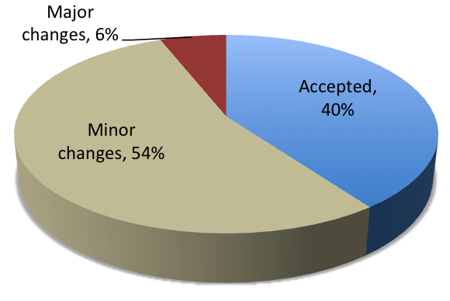
Reduced Analyst Workload
The new locator provides better hypocentre estimates for the ISC review
Only 6% of the events undergo major changes
Split/merge events, or change a large number of phases
40% of the events are accepted
54% of the events undergo minor changes
Better depth estimates
Depth is fixed by the editors for 10% of the events
The vast majority of phases are correctly identified
1% of the phases are changed
Associate/disassociate phases
Rename phases
Amplitudes and magnitudes
Outliers automatically removed

Slide 5
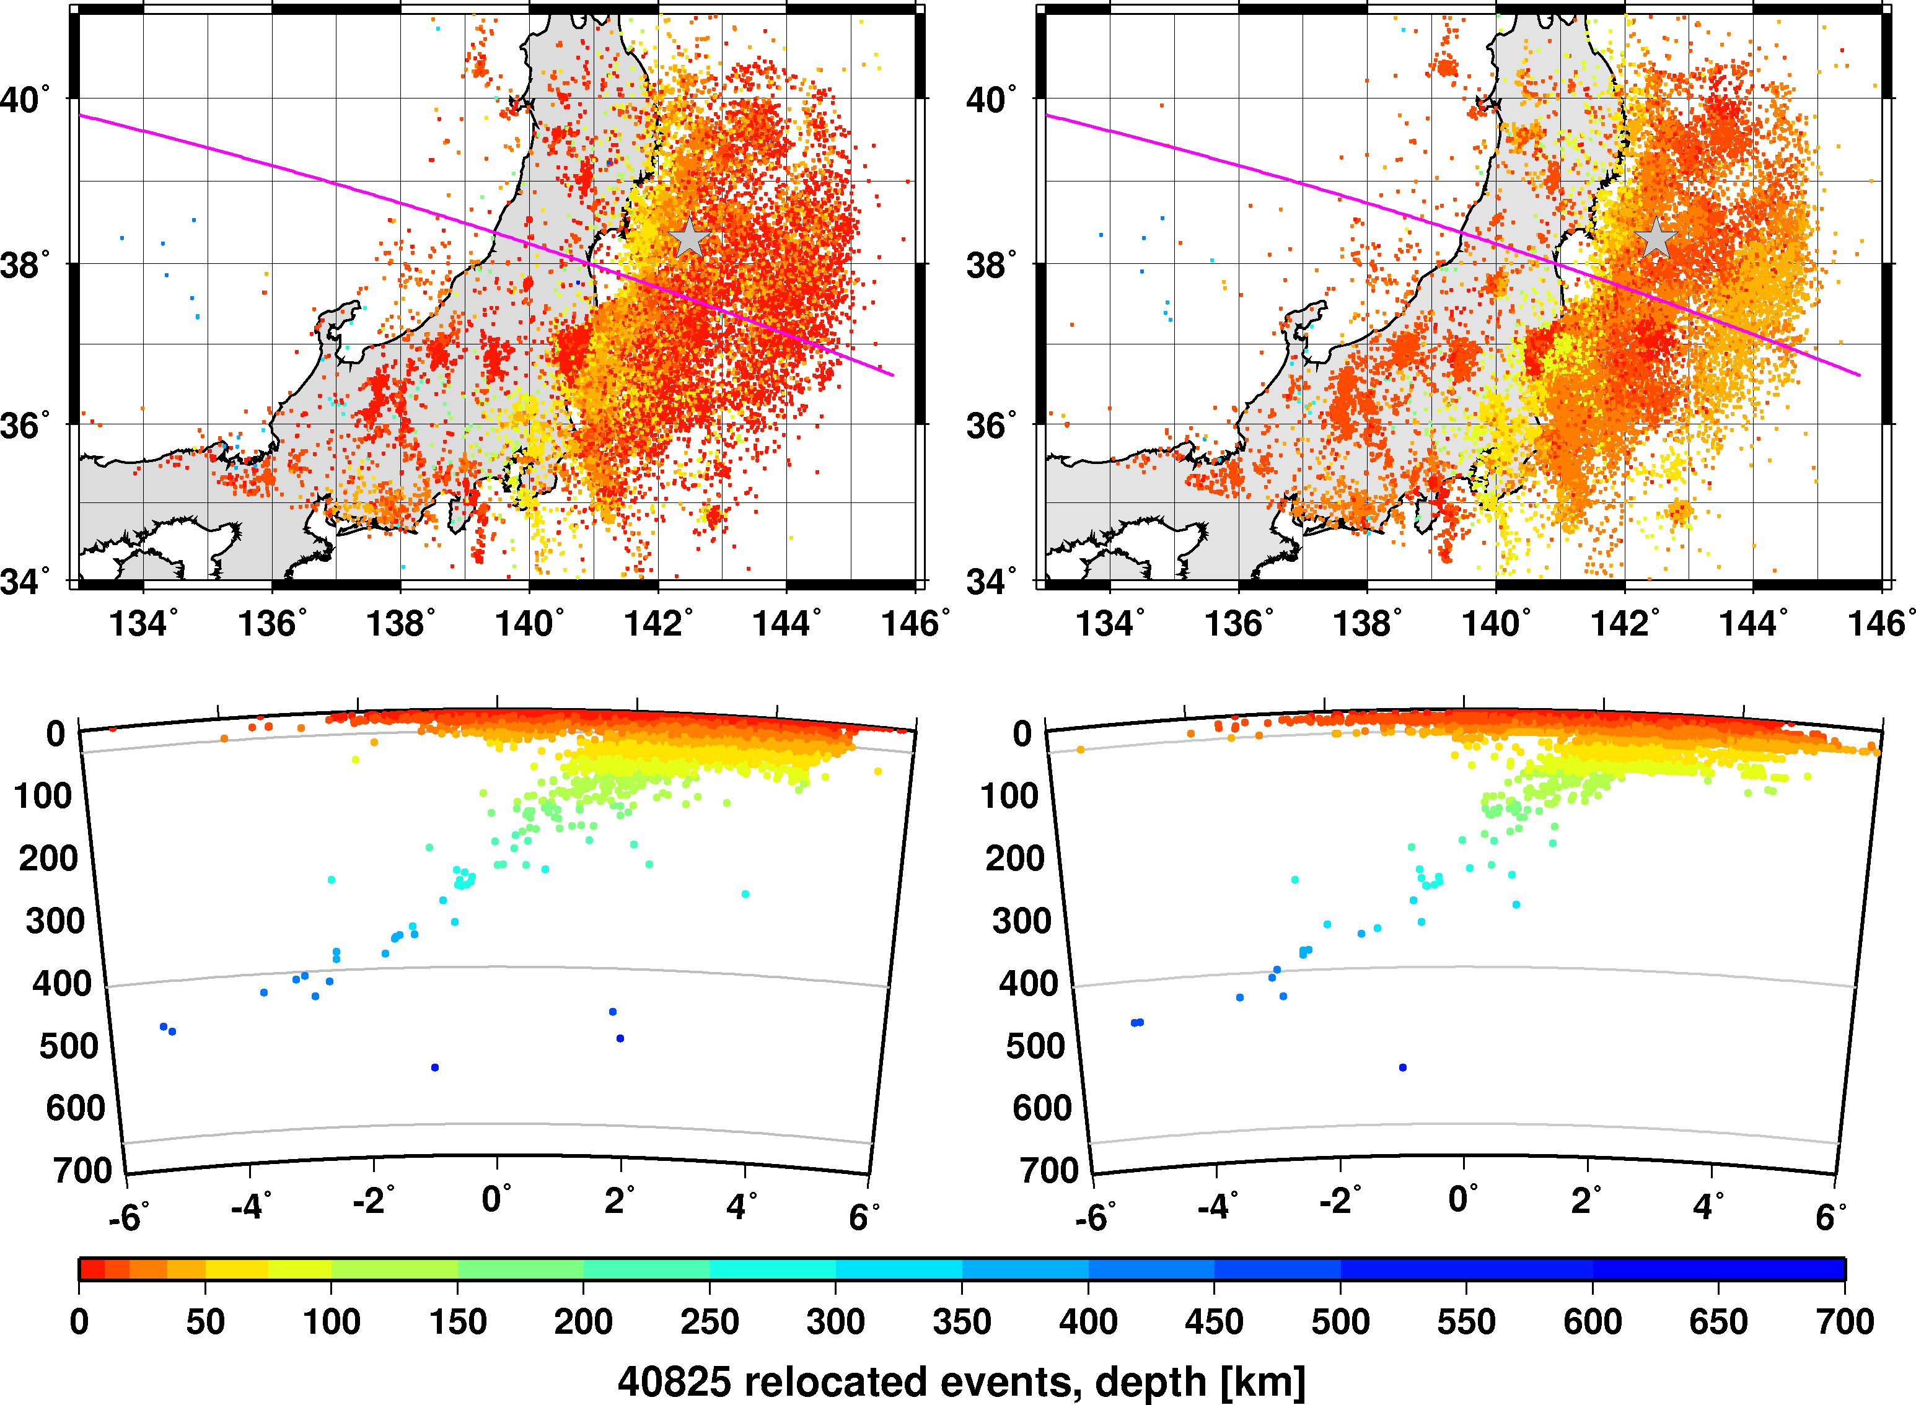
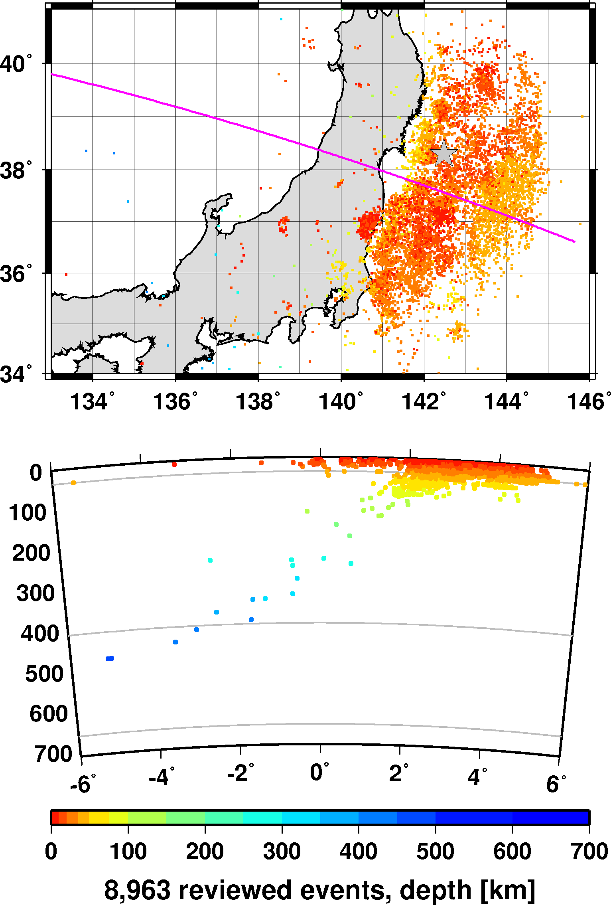
Tohoku, March – May, 2011
ISC relocation
ISC review
Events are better clustered
Better resolution in depth

Slide 6
Regional Seismic Travel-Times (RSTT)
The RSTT rapid ray-tracing capabilities allow the use of realistic 3D models in routine operations
RSTT package
Developed by DoE labs LLNL, LANL and Sandia
Global 3D upper mantle velocity model
Crust: unified model in Eurasia, Crust2.0 elsewhere
Travel-time prediction utilities for regional (Pn/Sn) and first-arriving crustal (Pg/Lg) phases
RSTT-enabled version of the ISC locator
Developed to test and evaluate RSTT performance
Uses Pn/Sn and optionally Pg/Lg (Pb/Sb/Sg) predictions
Part of the open-source ISC locator package
Not part of standard ISC operations

Slide 7
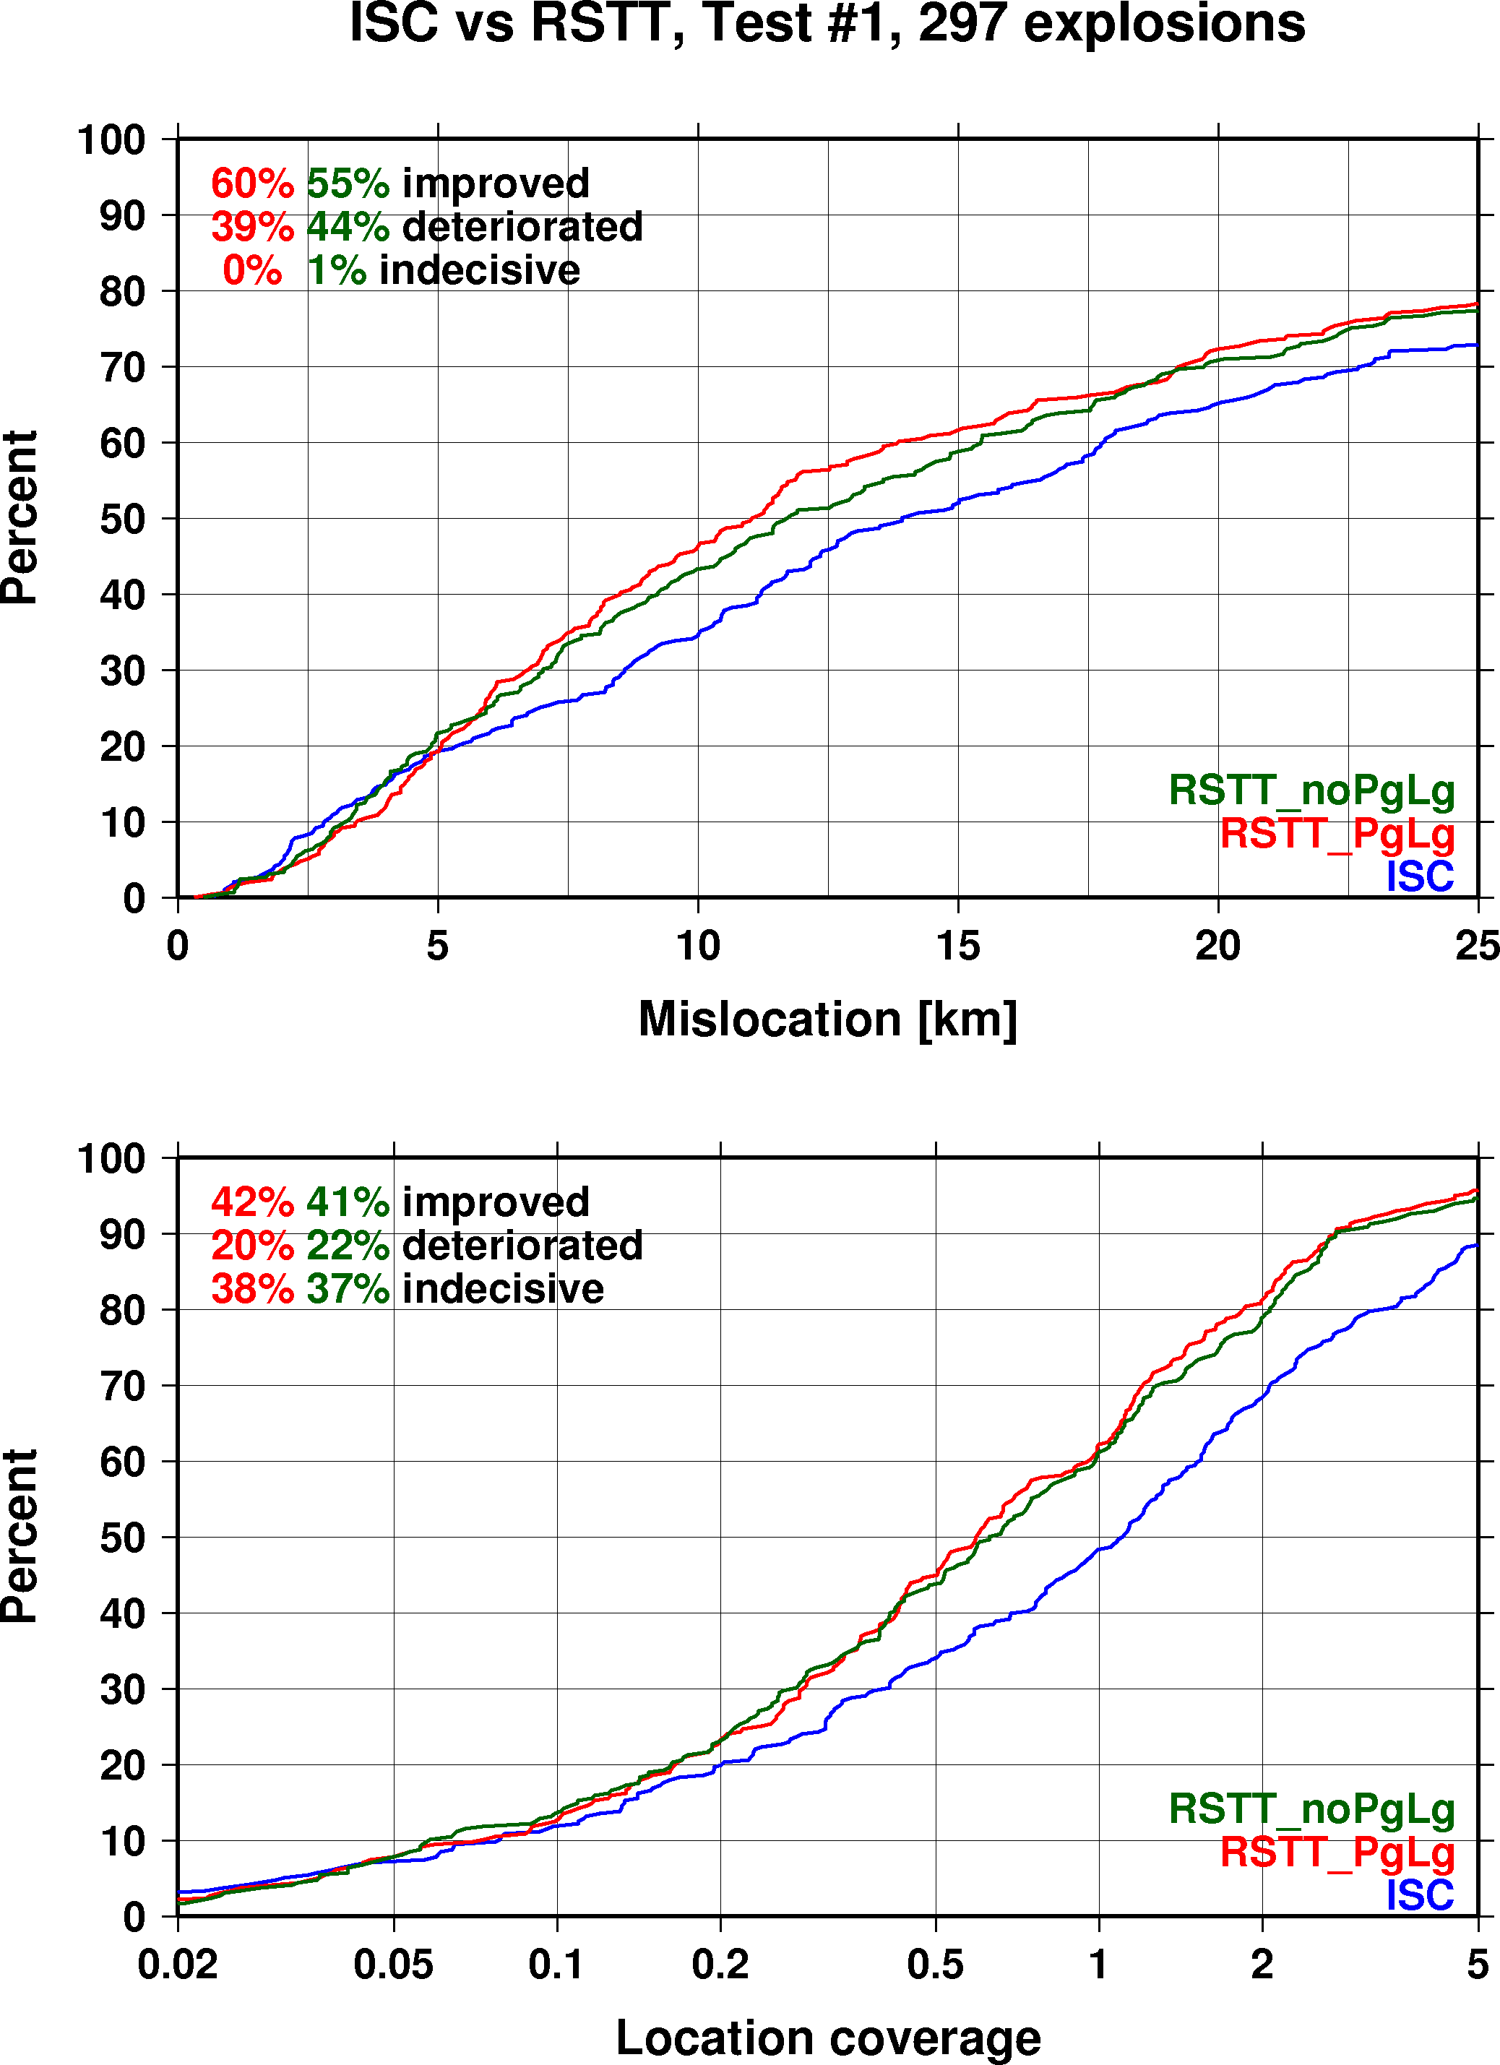
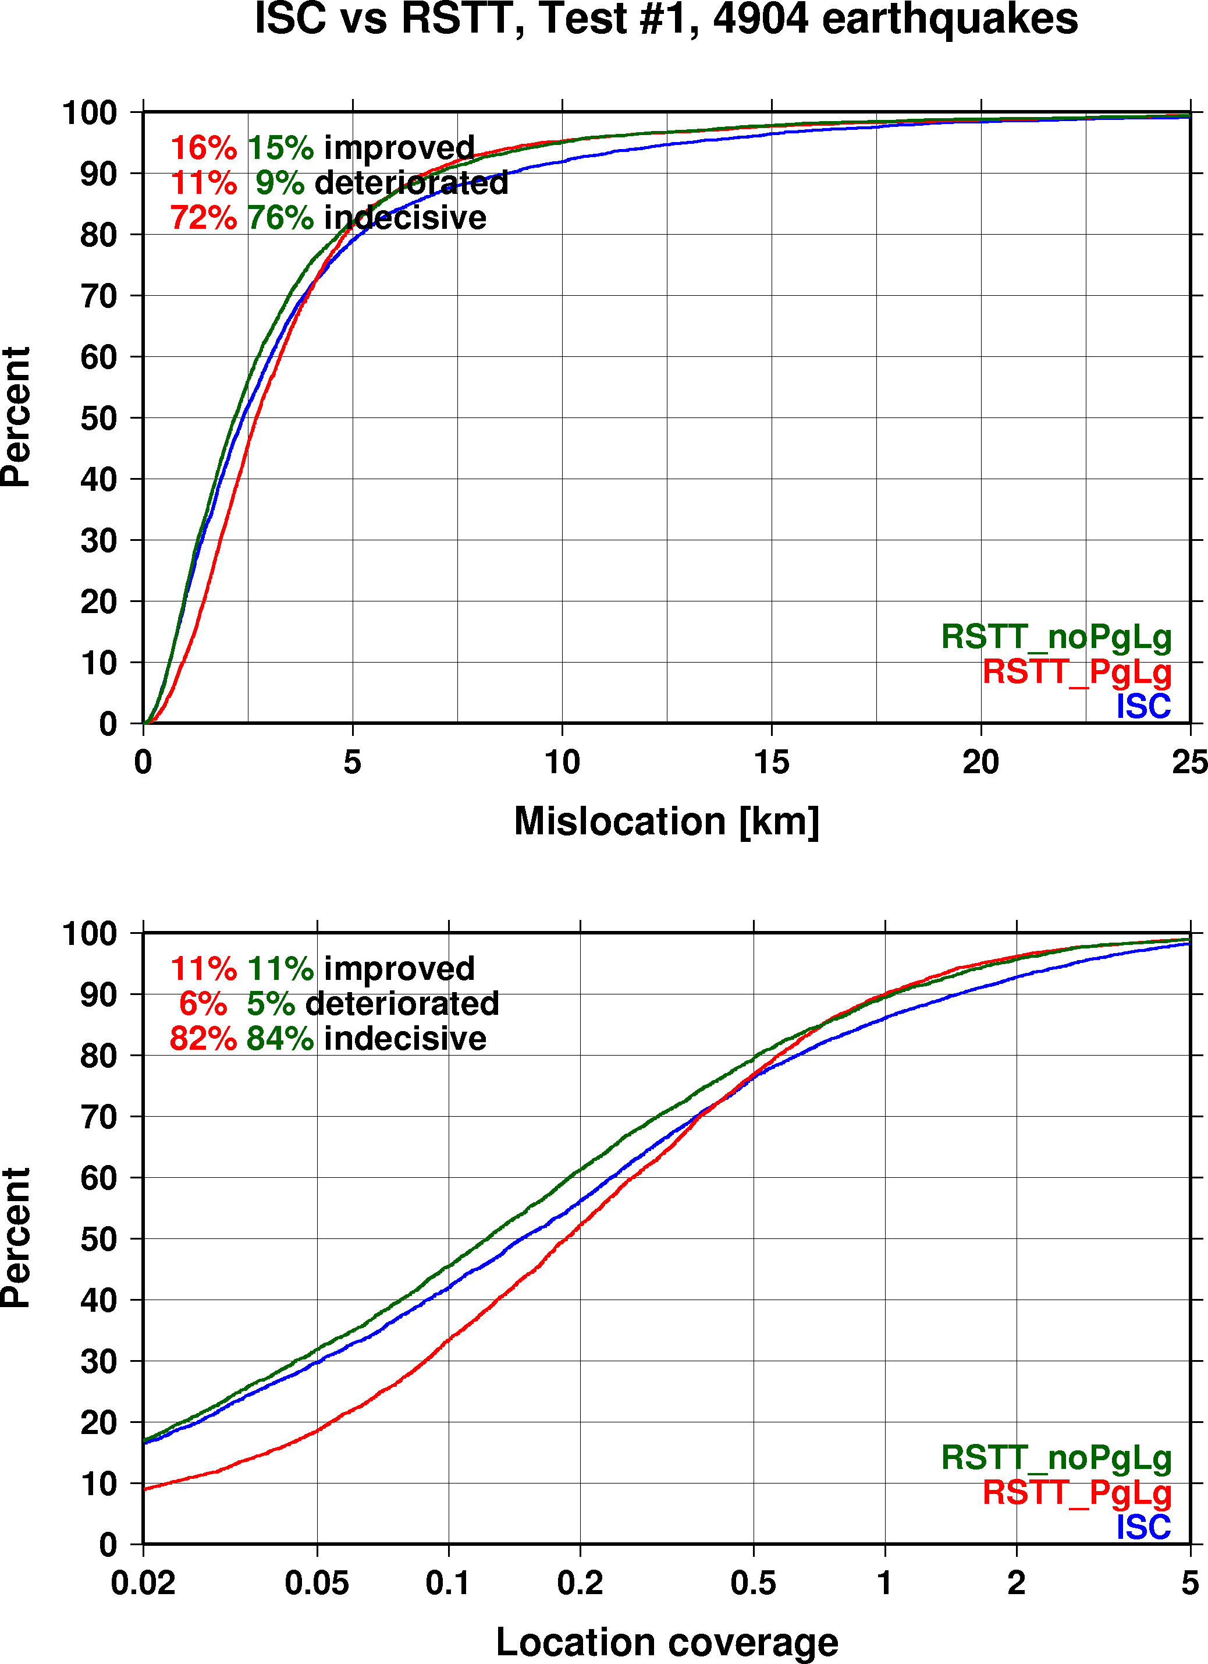
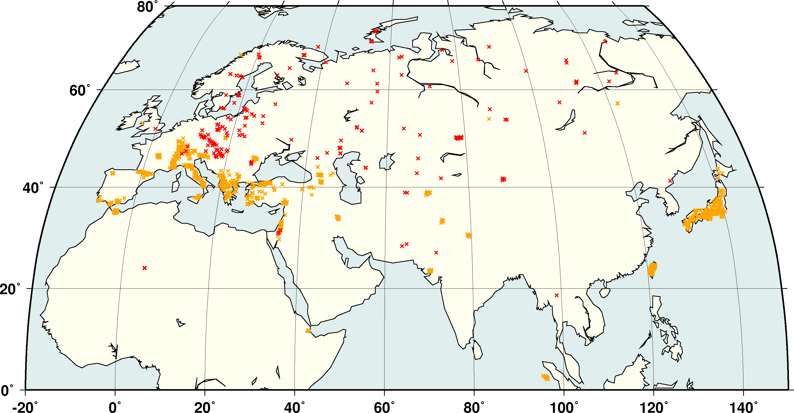
RSTT Relocation Tests
Explore whether the RSTT package could be used in future ISC processing
Relocated some 5,600 GT0-5 events in Eurasia
Most GT evens are very well recorded – improvements are expected in the tails
Relocation Tests:
1) RSTT phases only
2) RSTT + ak135
With and without Pg/Lg

Slide 8
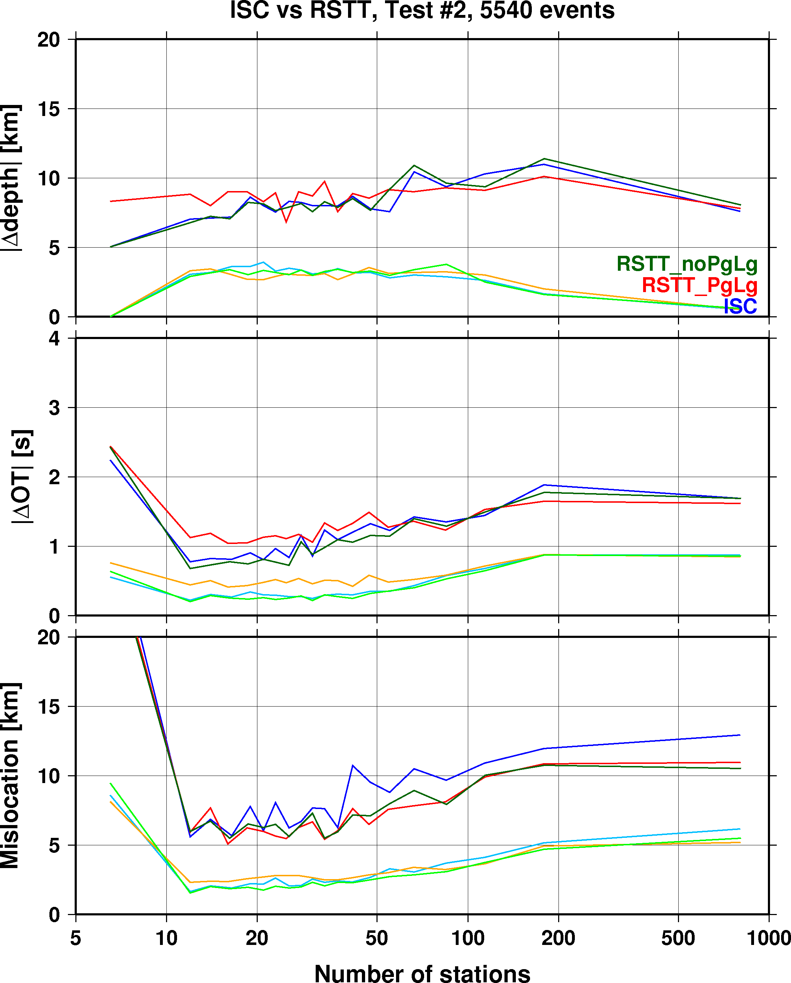
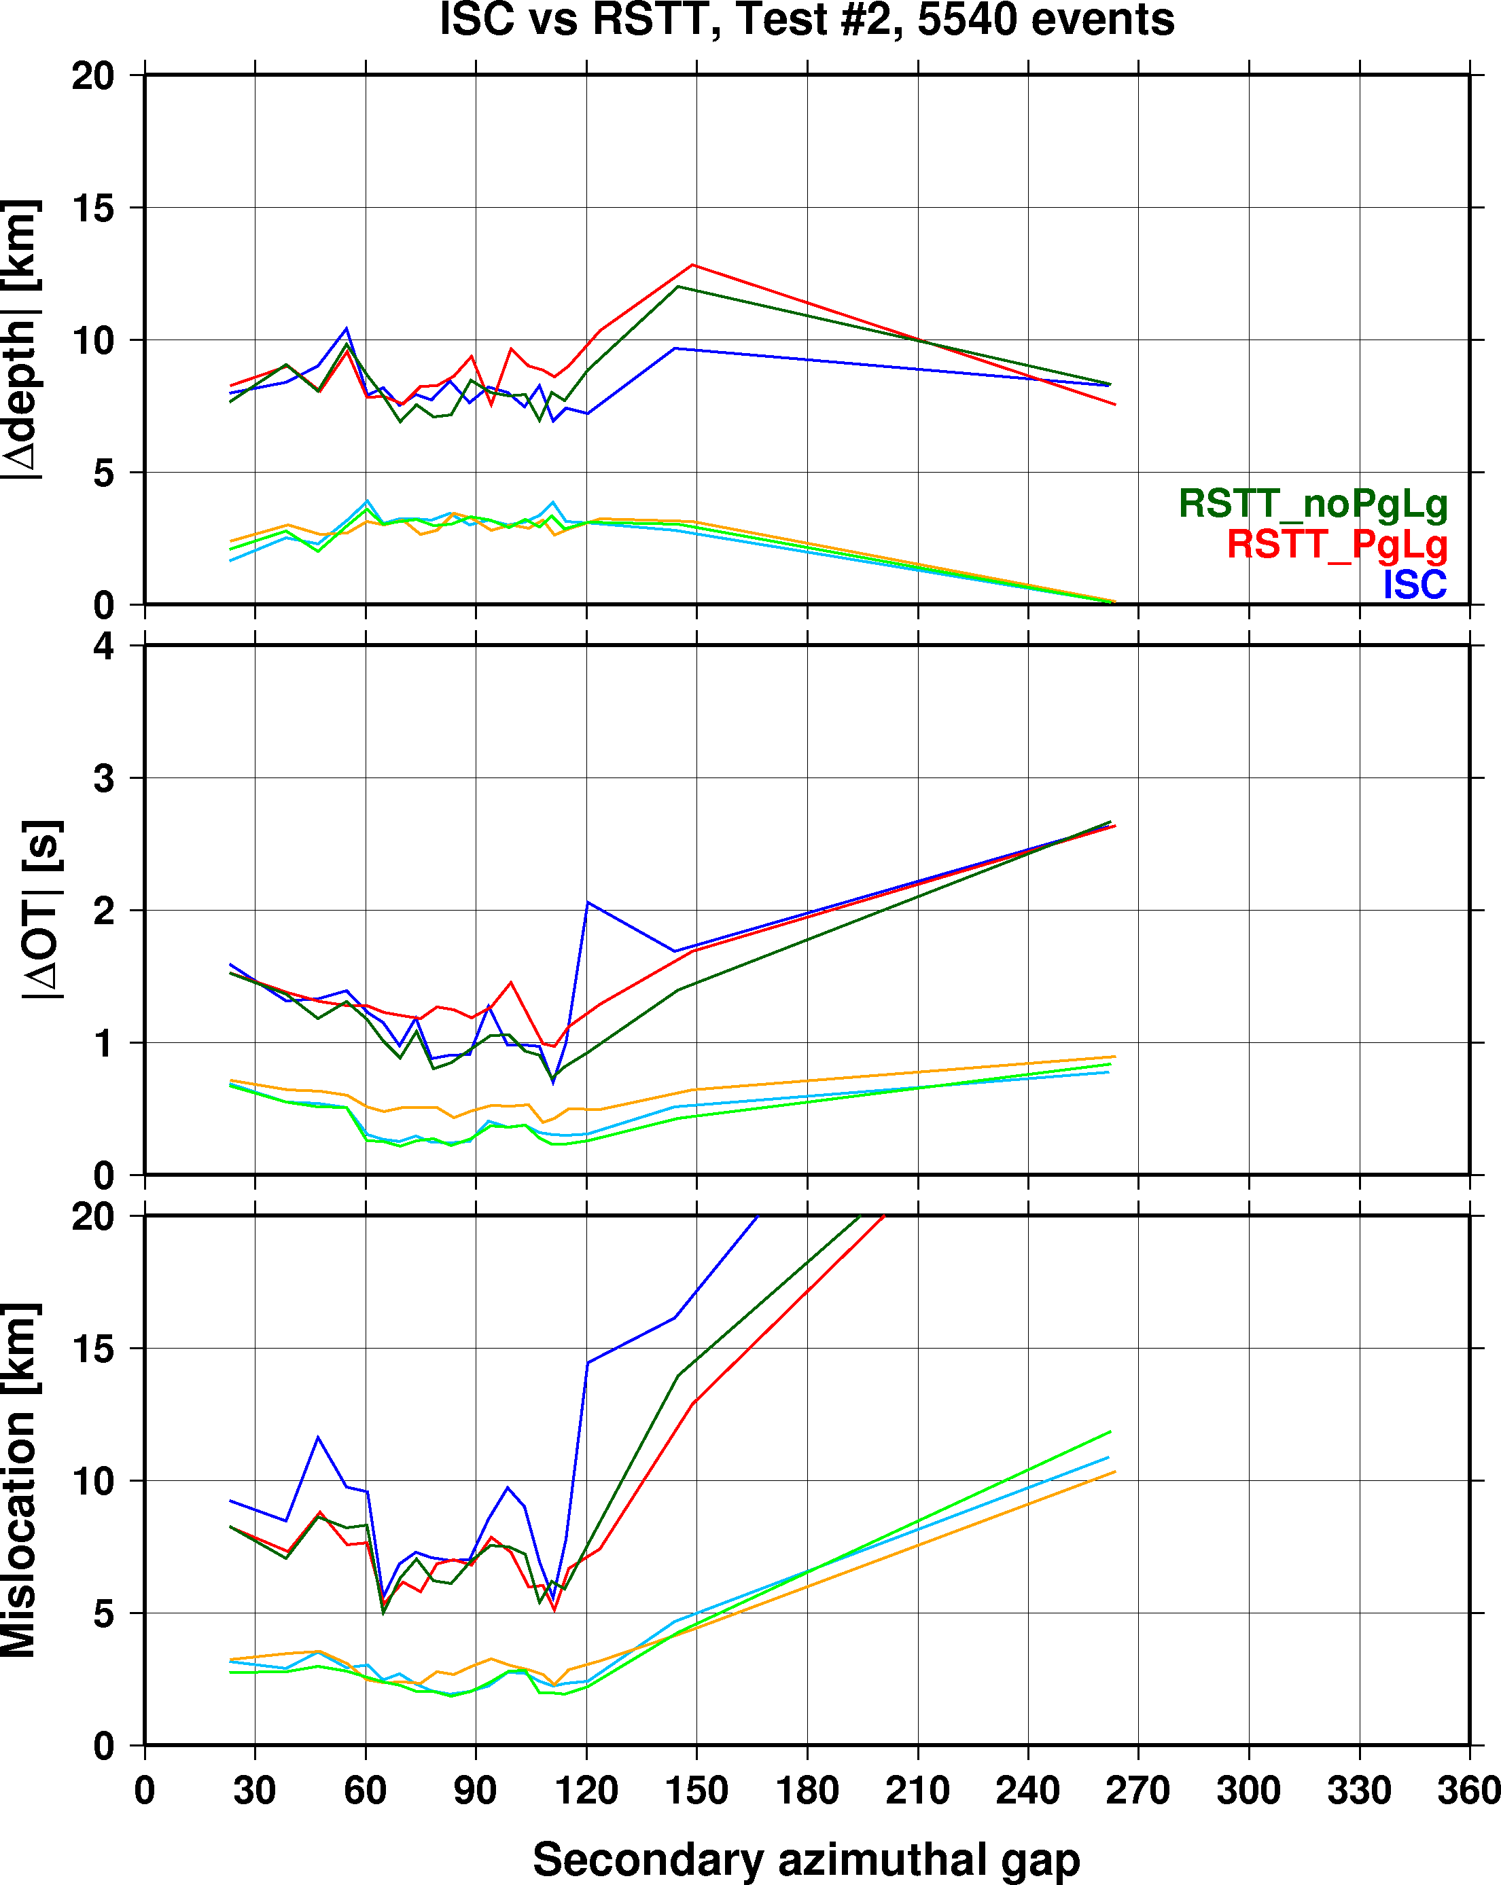
Improvements due to RSTT
90% percentile
median
More pronounced improvements with increasingly unbalanced networks

Slide 9
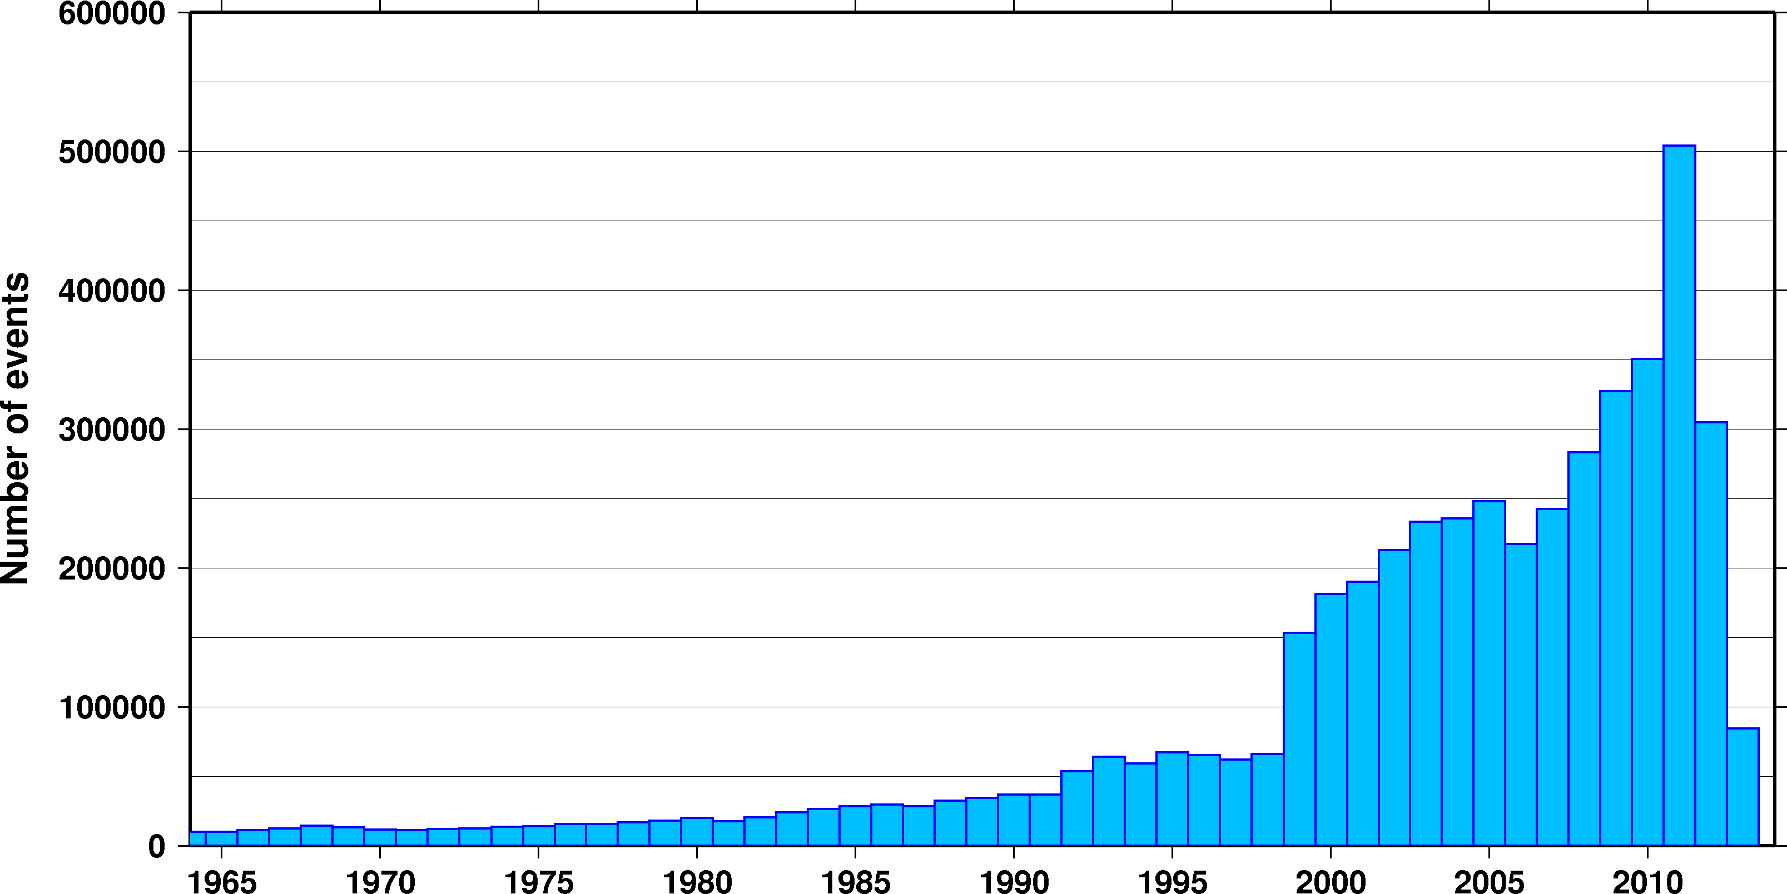
Evolution of ISC Procedures
Uniform reduction, JB, first-arriving P
Surface wave amps
MS calculated
ISC website
ISC database
First-arriving S
IASPEI phase ids, error ellipse
ak135 tables
New locator
The current ISC Bulletin is far from homogeneous
The robust performance of the new ISC locator offers the opportunity to rebuild the ISC Bulletin

Slide 10
Rebuilding the ISC Bulletin
Objective
Provide a homogeneous bulletin of the seismicity of the Earth
Apply uniform procedures
Follow IASPEI standards
Phase list, magnitudes, event type
Introduce data sets that were not processed at the time
Historical, pre-1964 data sets
Scanned ISS bulletins (1918-1964)
Recently acquired historical network bulletins (JMA, WEL)
Manual data entry from original station reports
Fill data gaps
Data from permanent and temporary networks
GSRAS, AWE, JEN, CLL, GSETT-2, MCO, TAP, EUROP, IASPBS, EAF, etc
Other types of data
focal mechanisms, fault planes, damage reports, bibliography, etc
Quality control
Correct known inconsistencies, rectify blunders
Date and time errors, amplitudes, event type, bogus events, etc

Slide 11
Conclusions
The new ISC locator
Operational since January 2011 (events since 2009)
Provides improved hypocentre estimates
Reduced analyst workload and increased productivity
RSTT evaluation
Pn/Sn predictions provide location improvements
Improvements diminish when Pg/Lg are used
Mixing regional RSTT and teleseismic ak135 TT predictions does not introduce baseline differences
The ISC locator is available for download at the ISC website
ISC Bulletin rebuild
Current focus is on the collection of new/old data sets
Will provide a homogeneous, high-quality bulletin

Slide 13
ISC analyst review
ISC review is typically 2 years behind real time
ISC Reviewed Bulletin is produced monthly
About 20% (3,500-5,000 per month) of events in the ISC Bulletin are reviewed by ISC analysts
An event is selected for review if
The magnitude is larger than 3.5, or
Several agencies provided genuine phase picks, or
It is reported in the IDC REB
All relocated events are reviewed
But not all reviewed events are relocated (e.g. small REB events)

