Slide 1
Earthquake nucleation on rough faults; laboratory constraints
Christopher Harbord*, Stefan Nielsen, Nicola De Paola, Bob Holdsworth
British seismology meeting, April 2017
*c.w.a.harbord@durham.ac.uk
Rock Mechanics Laboratory, Durham University, Durham, UK

Slide 2
Contents
Background and study motivation
Methodology
Experimental results
Discussion of results using current nucleation criteria
Conclusions and a little speculation

Slide 3
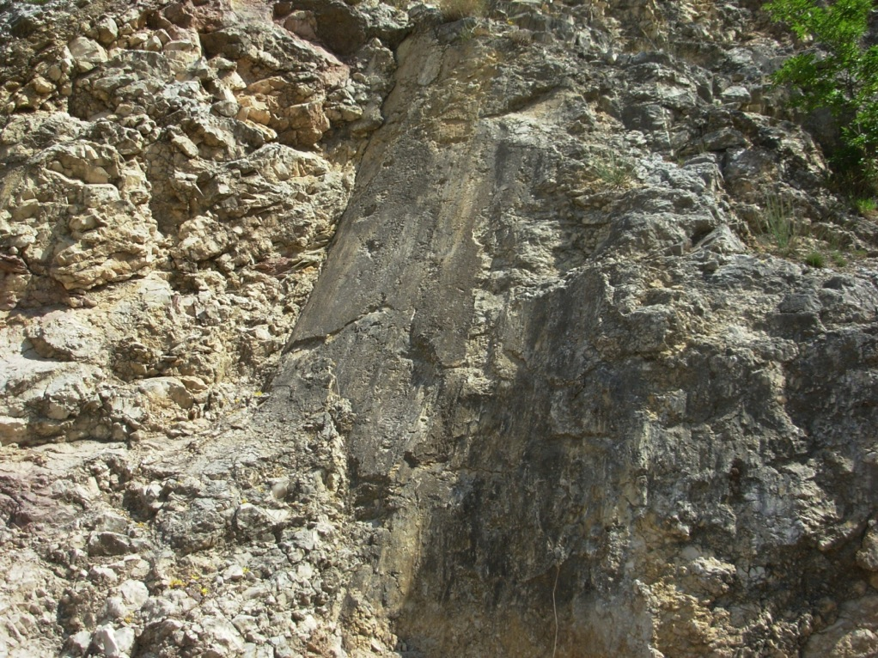
Earthquakes and faults
Most earthquakes
occur due to sudden
slip on pre-existing
fault surfaces...
…. the physics and
mechanics of the
process is controlled
by the frictional
properties of the
slip zone
Slip surface in active carbonate fault zone, Gubbio Fault (Italy)
Notes:
Read ……

Slide 4
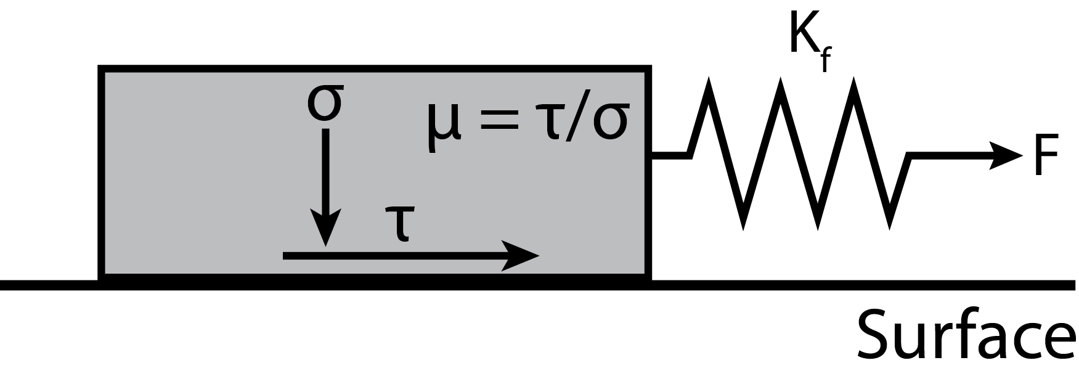

a-b > 0, Stable sliding
Earthquake nucleation: Rate and state friction
$$μ$$
Slip

Slide 5
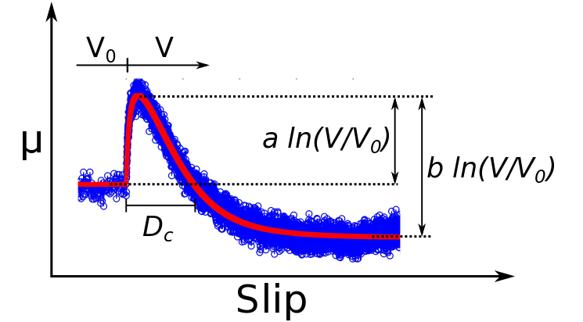

a-b < 0, Unstable sliding
Earthquake nucleation: Rate and state friction
$$μ$$
Slip
$$μ$$
Slip

Slide 6
Earthquake nucleation: Rate and state friction
-Explains gouge friction well and the ‘spectrum of fault slip’ (e.g. Marone 1998, Leeman 2016 etc.)- used by many seismologists to model fault slip.
-What about inhomogeneity?

Slide 7
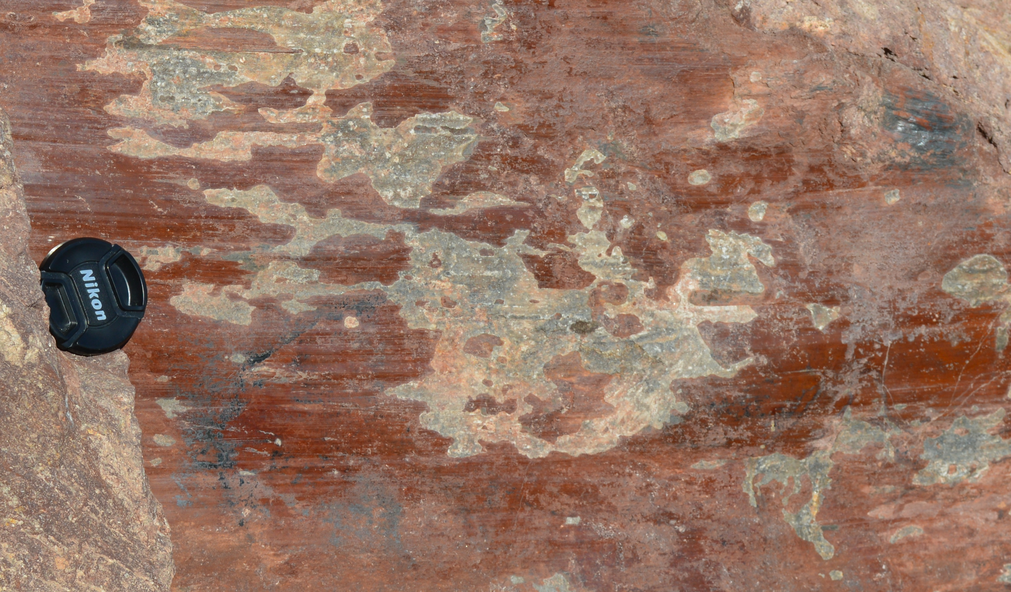
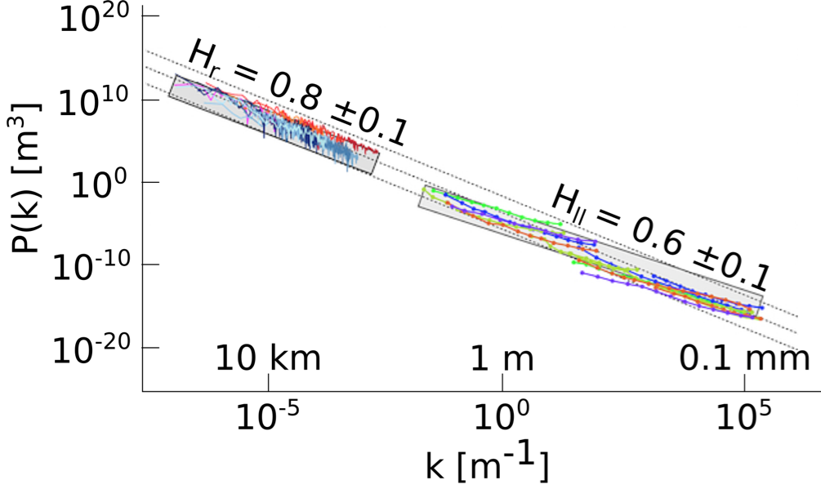
Fault zone roughness
Faults are rough over many orders of magnitude, a form of inhomogeneity
In theory and limited experimentation, roughness can be shown to control the strength, nucleation size, and the critical slip distance, D_{c}
Fault mirror at the Hoover Dam
Modified after Candela et al. 2012

Slide 8
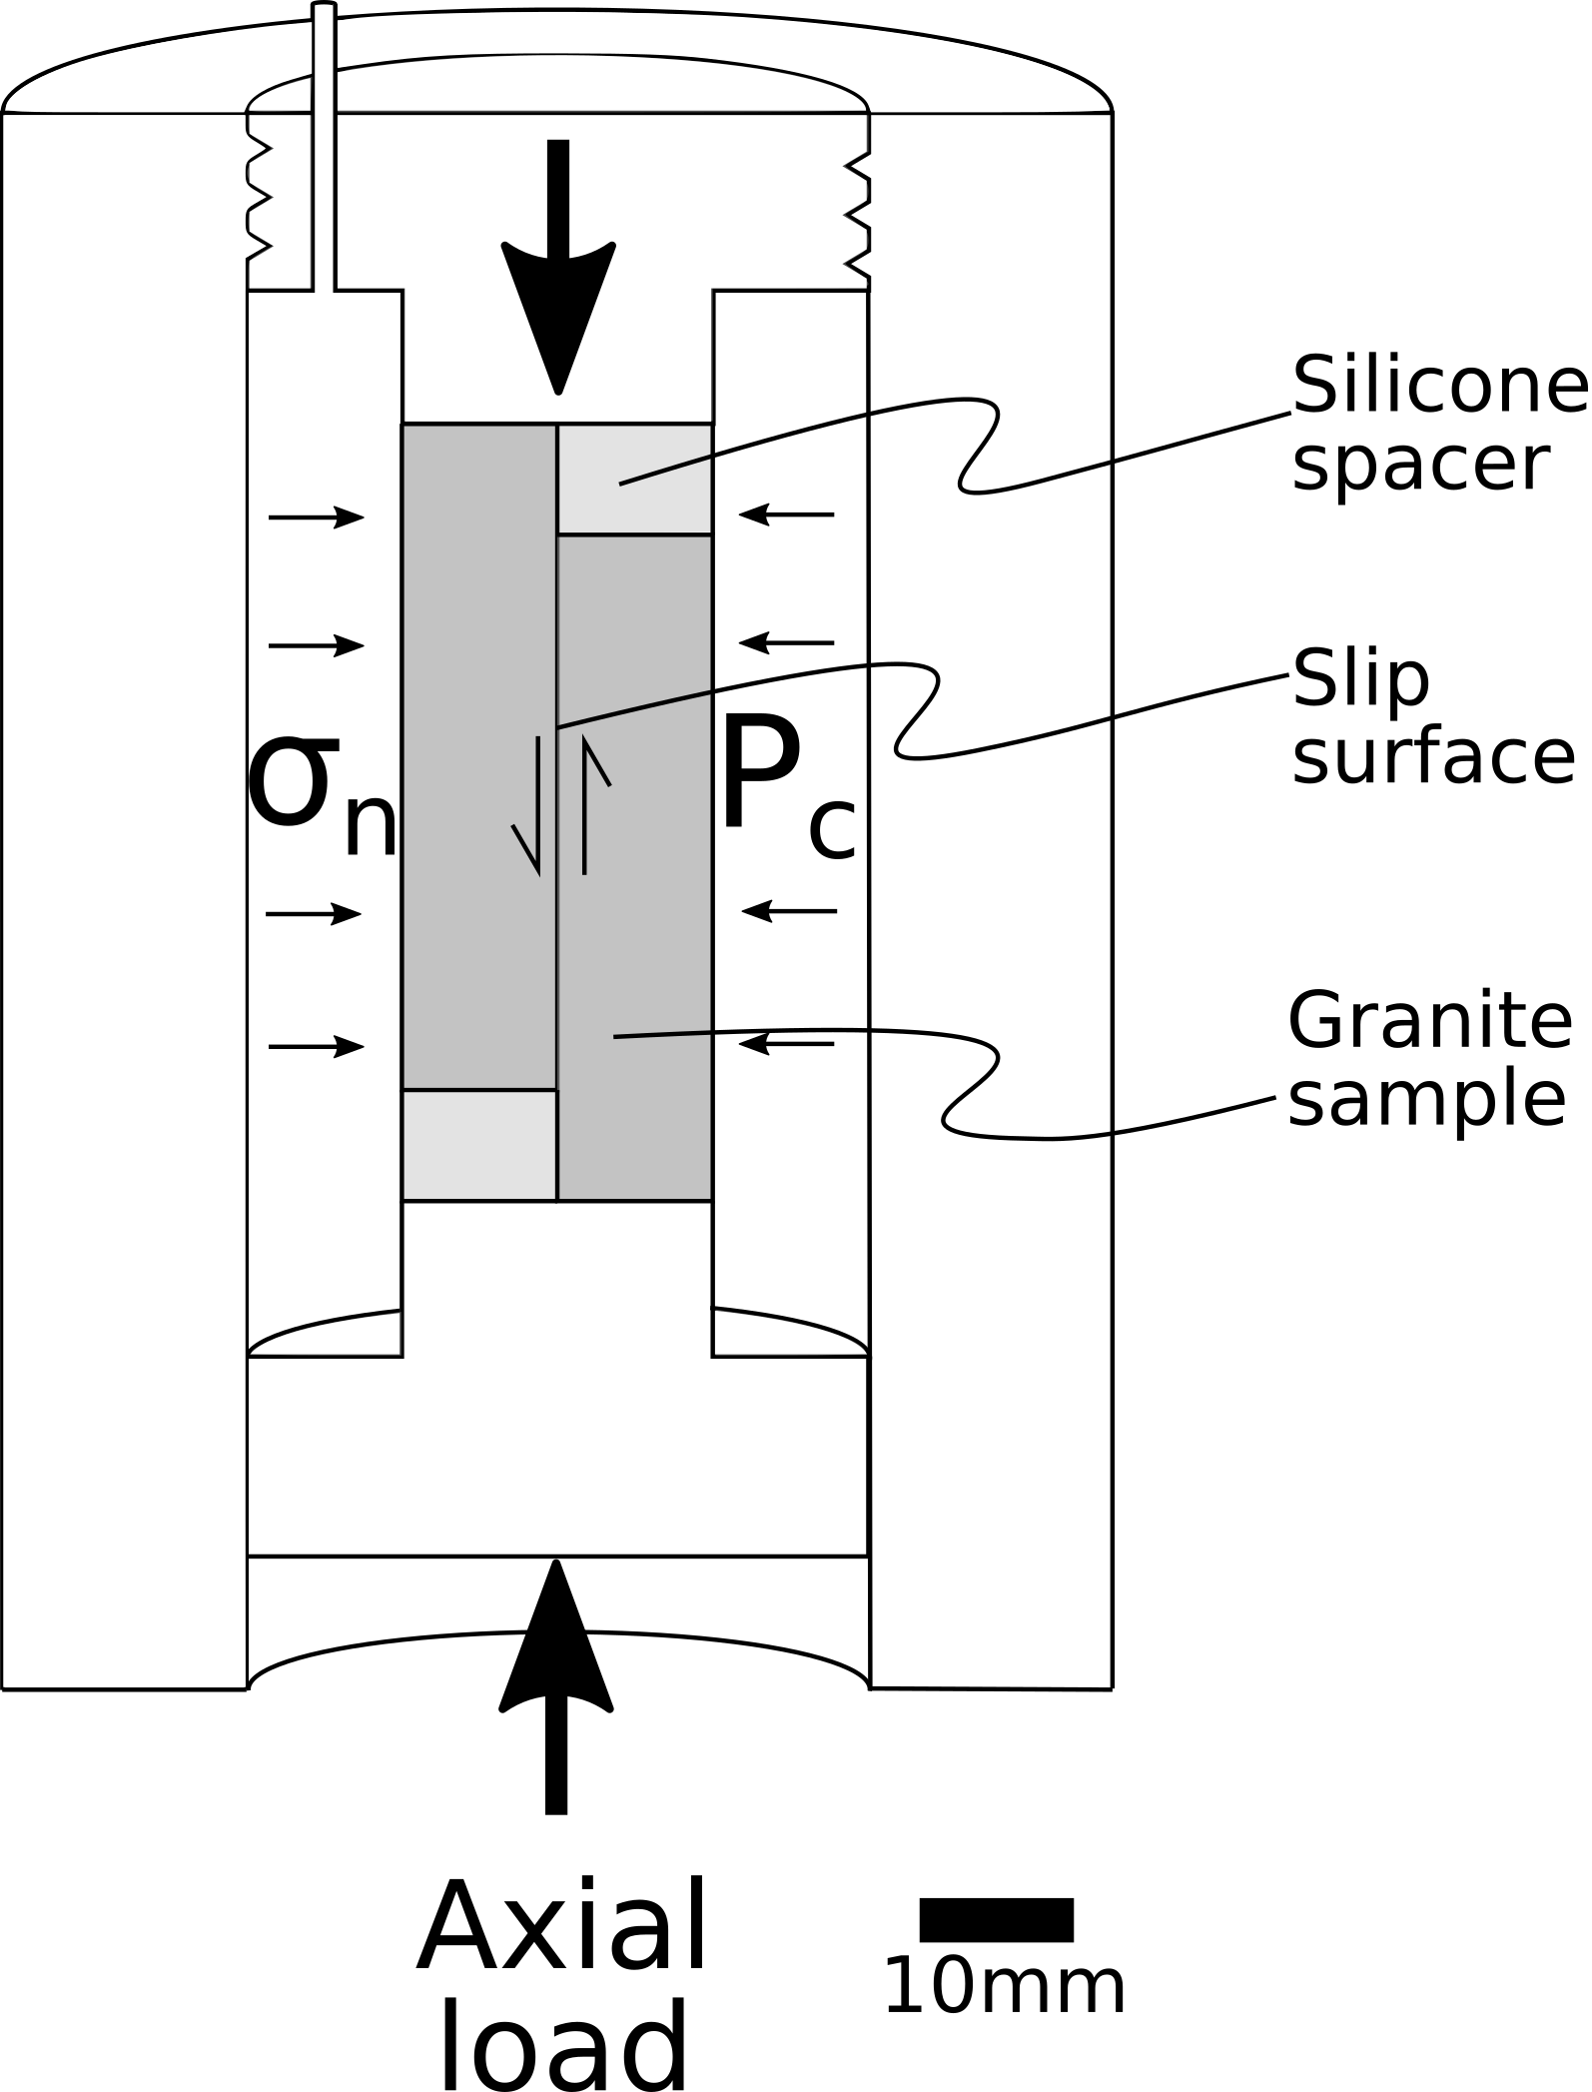
Methodology
We utilise vertically pre-cut westerly granite to create a ‘direct shear’ geometry
Samples are polished to a fine (<1 𝜇m) finish, and a range of grits applied
Normal stress varied at 30, 100, 150 & 200 MPa

Slide 9
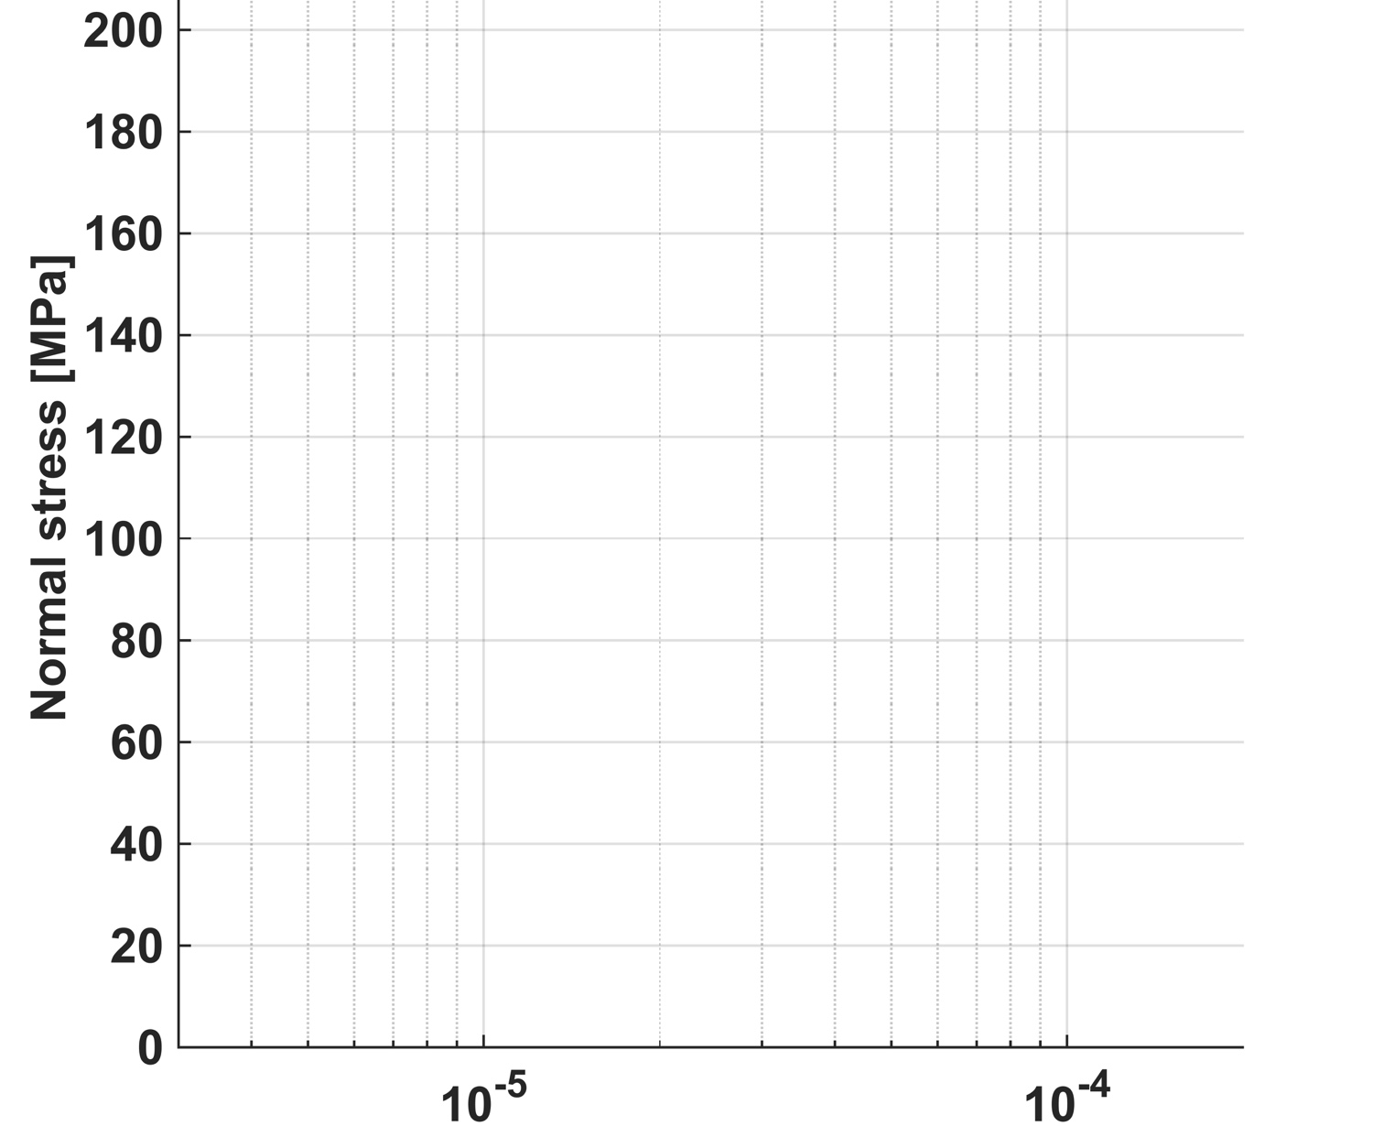
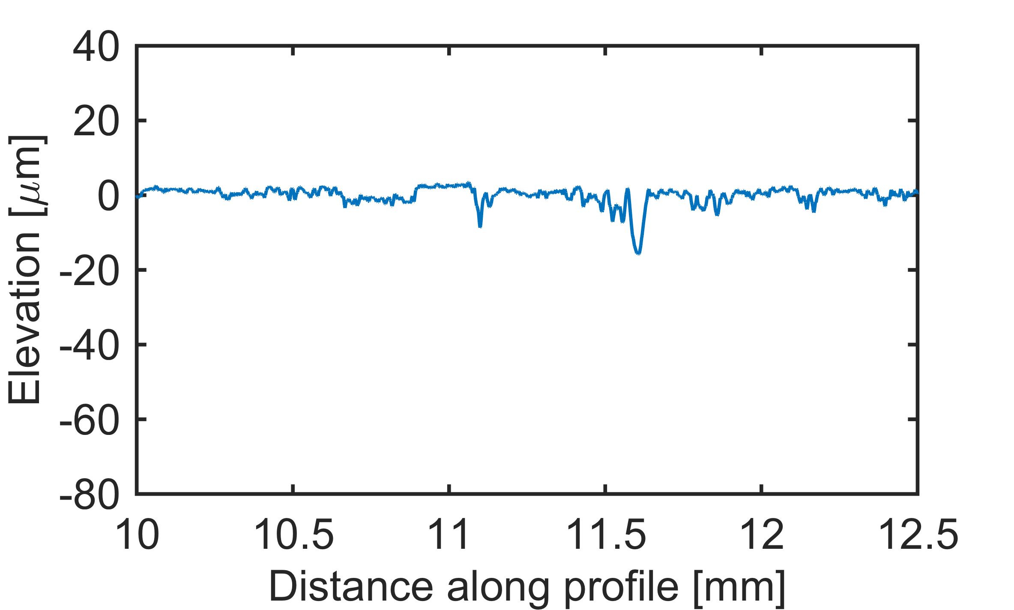
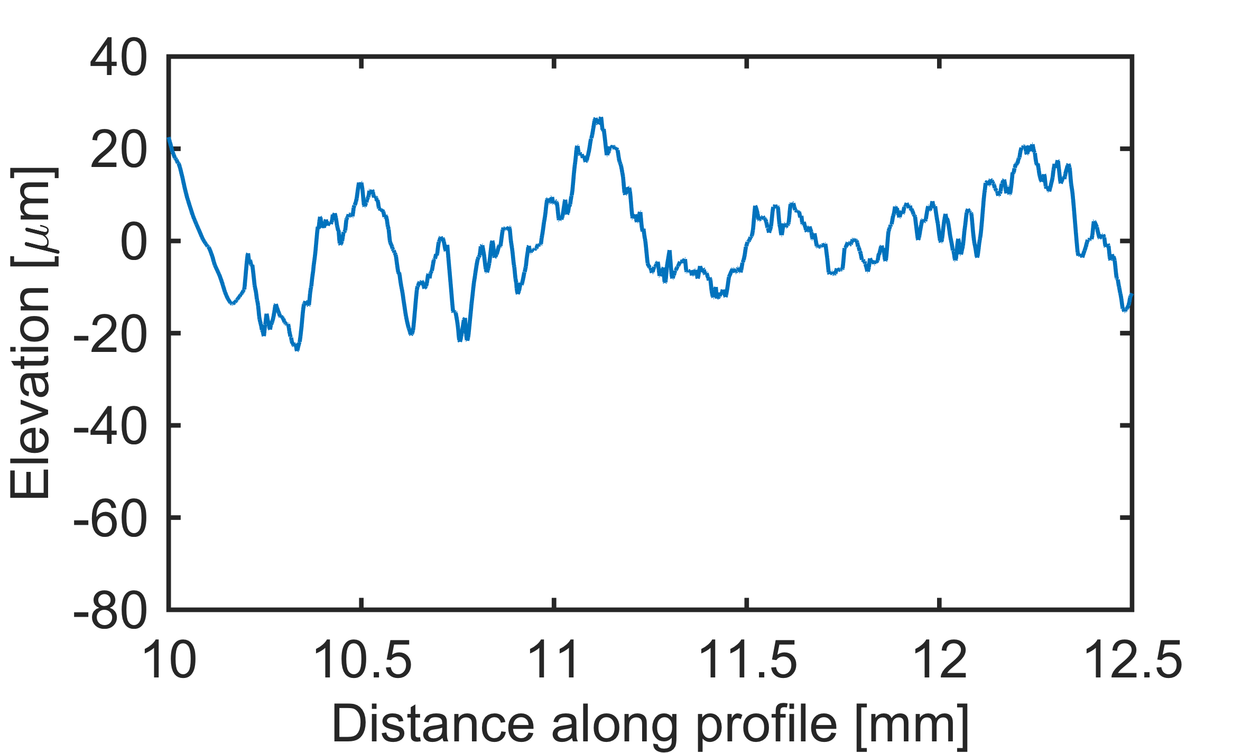
Smooth
Rough
Z_{rms} [m]

Slide 10
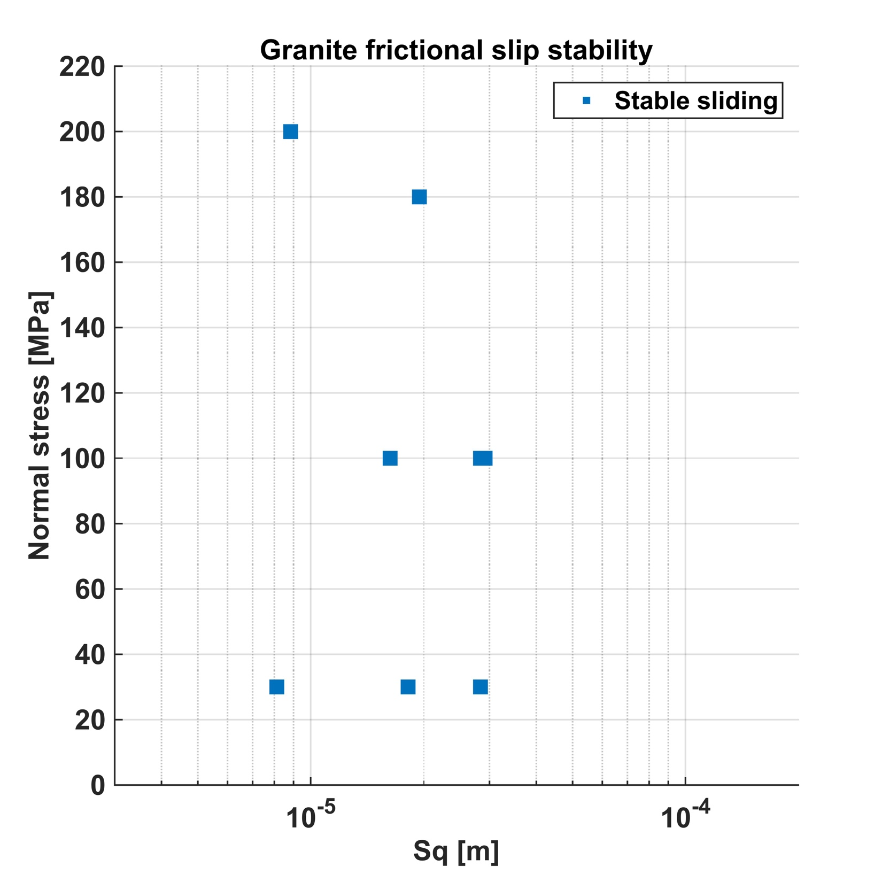
5
10
50
100
Z_{rms} [m]

Slide 11
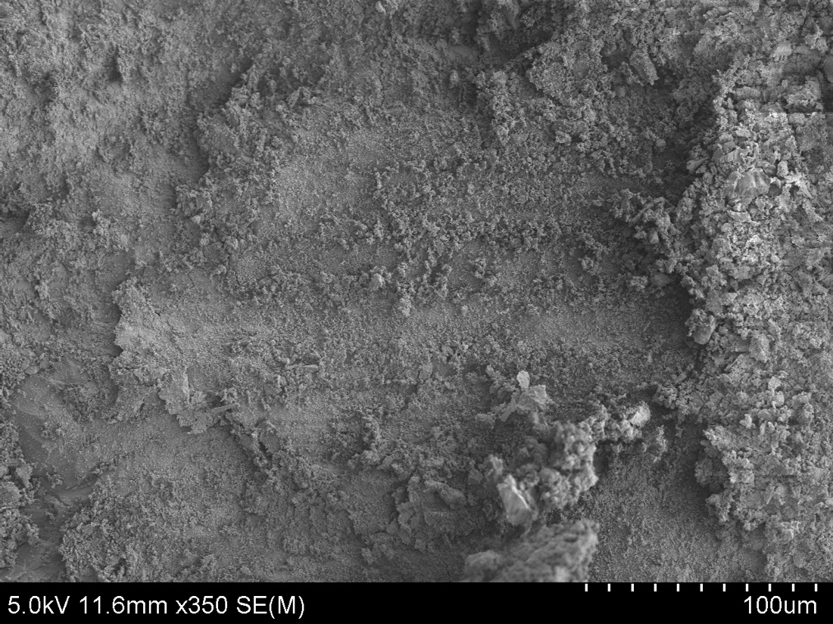

Velocity ${μm s}^{−1}$
5
10
50
100
Z_{rms} [m]

Slide 12
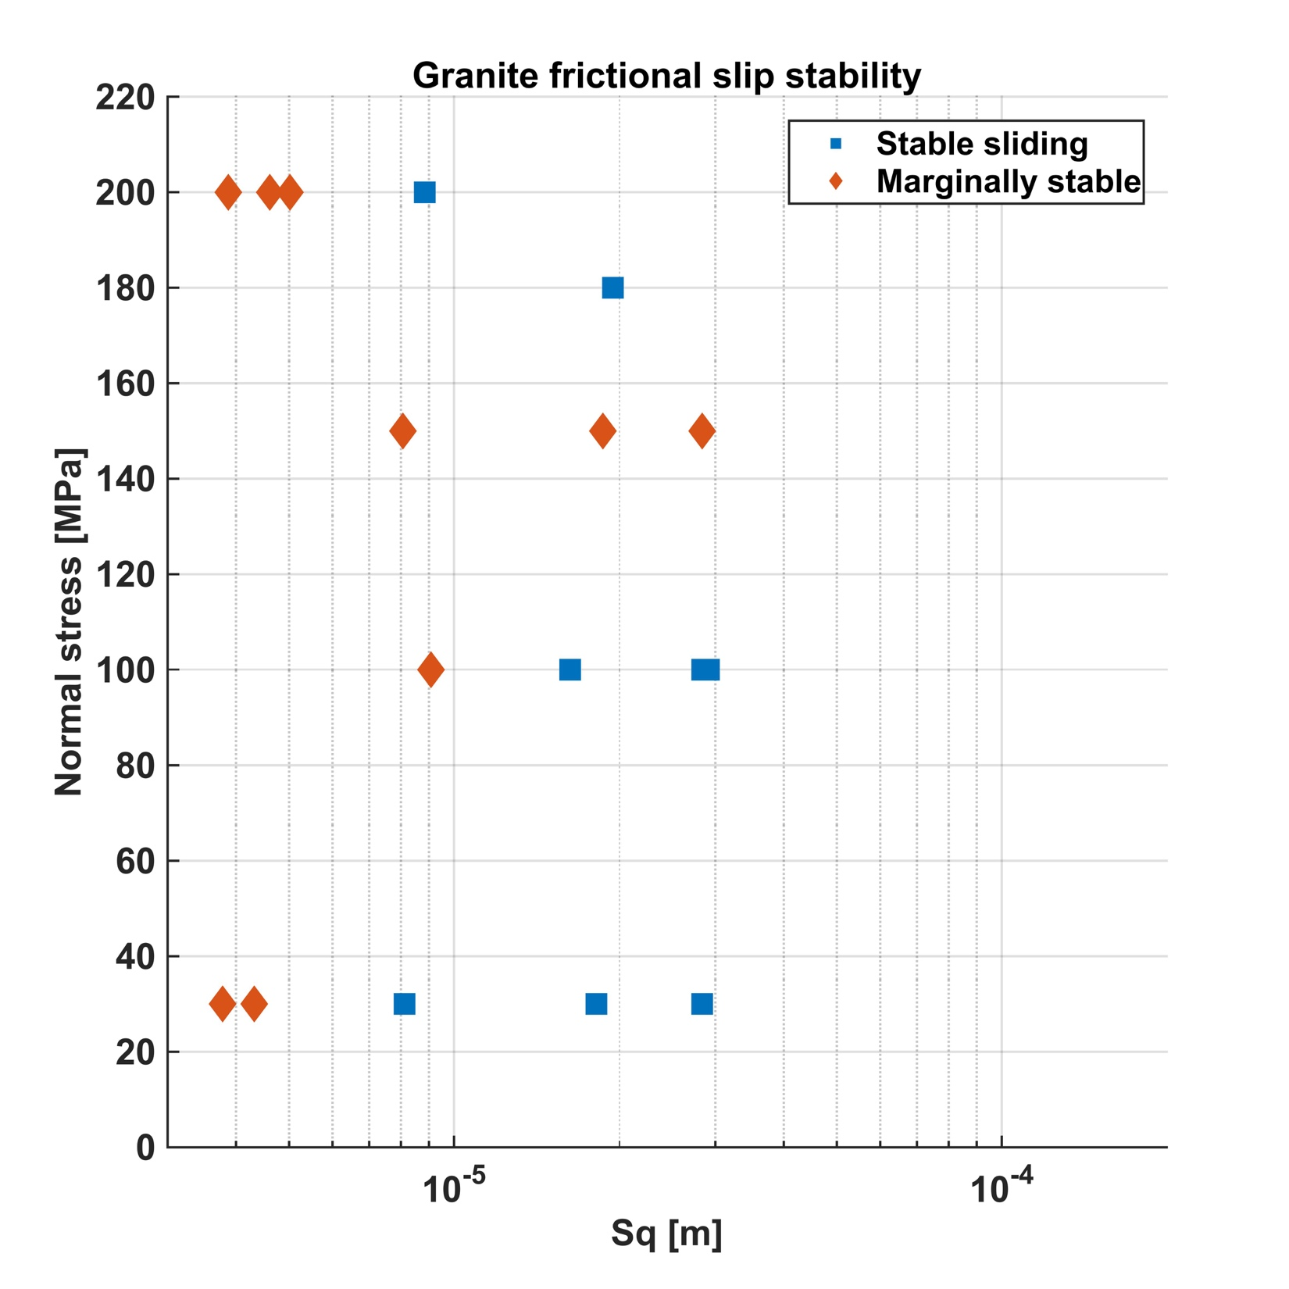
5
10
50
100
Z_{rms} [m]

Slide 13
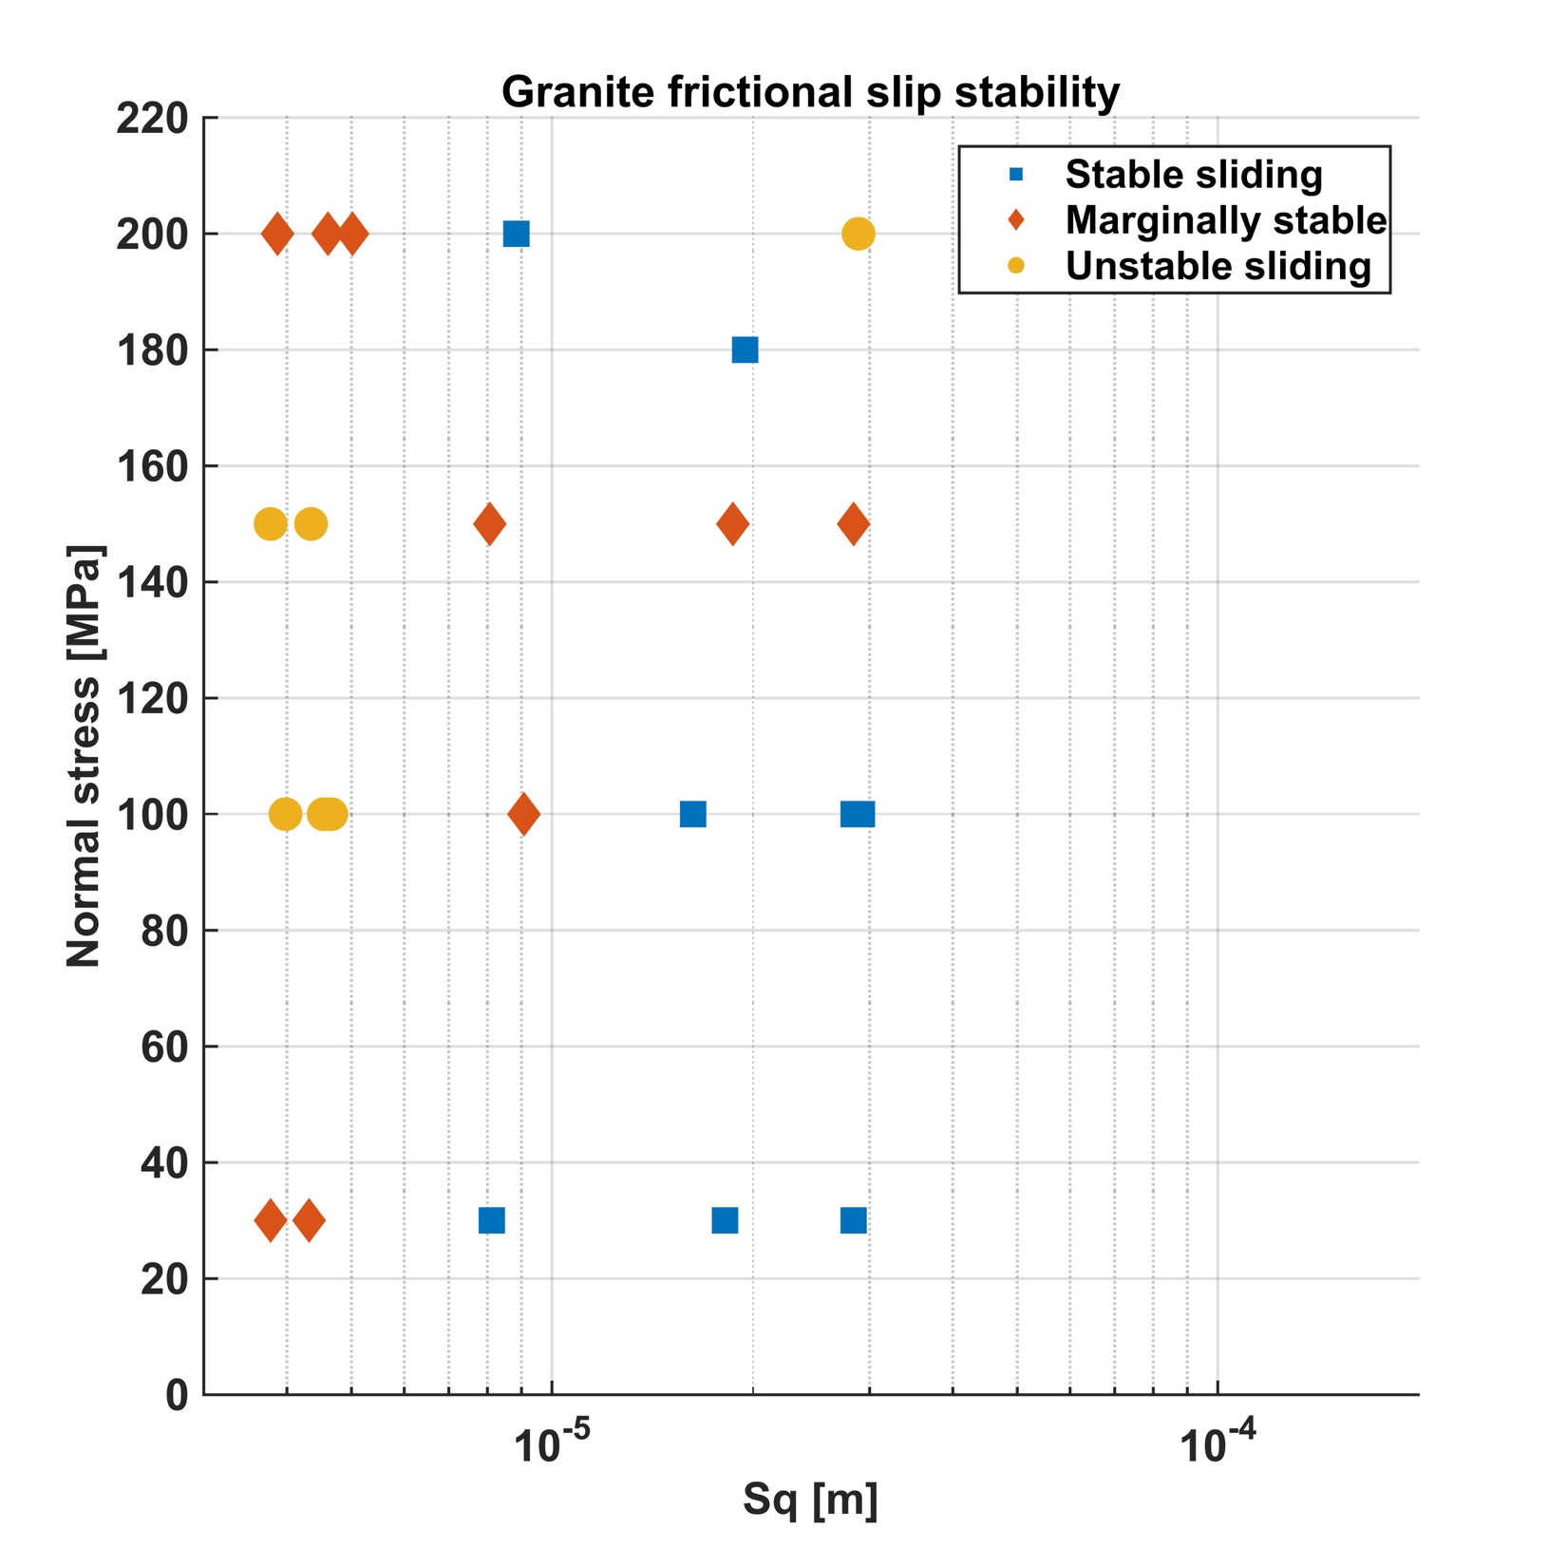
5
10
50
100
Z_{rms} [m]

Slide 14
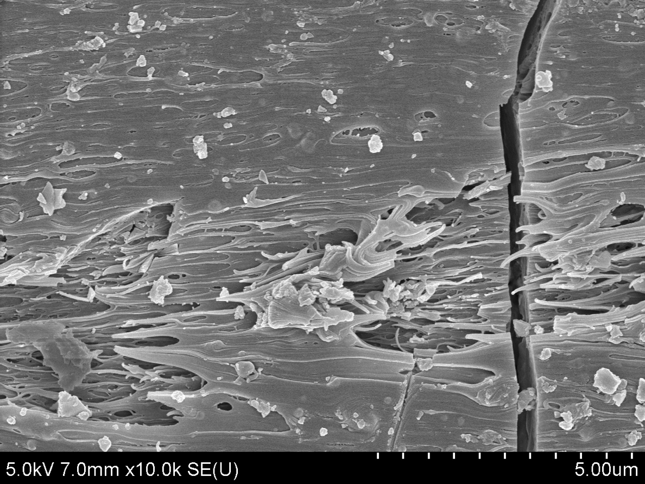

Velocity ${μm s}^{−1}$
5
10
50
100
Z_{rms} [m]

Slide 15
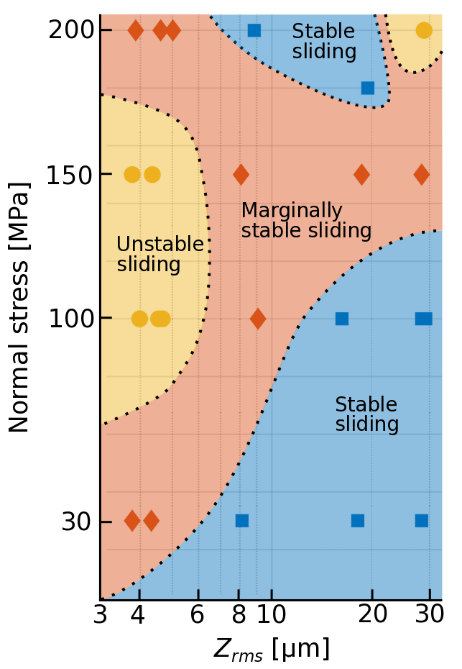
Stability map
At low Sq (2-4x10⁻⁶m) instability occurs at 100-150MPa with transitionary behaviour at 30 & 200MPa
At high Sq (3x10⁻⁵ m) instability occurs at high normal stress
Intermediate Sq (0.8-2x10⁻⁵m) complicated, with mixed sliding behaviours
Clear positive relationship between normal stress and roughness defining low limit of stable/conditionally stable regime

Slide 16
VS friction → Stress drop

Slide 17
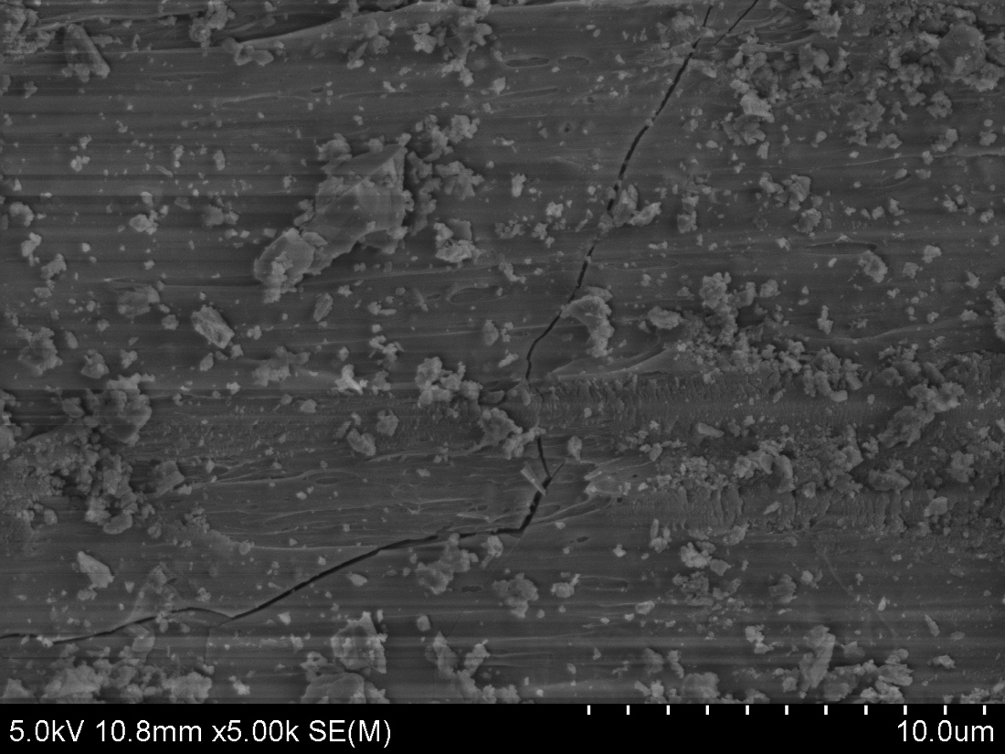
VS friction → Stress drop

Slide 18

A departure from RSF?
K_{c} should increase with normal stress = more instability
Velocity strengthening friction preceding stress drop gives negative K_{c,} yet we see instability
$$K_{c}=\frac{σ(b−a)}{D_{c}}$$

Slide 19
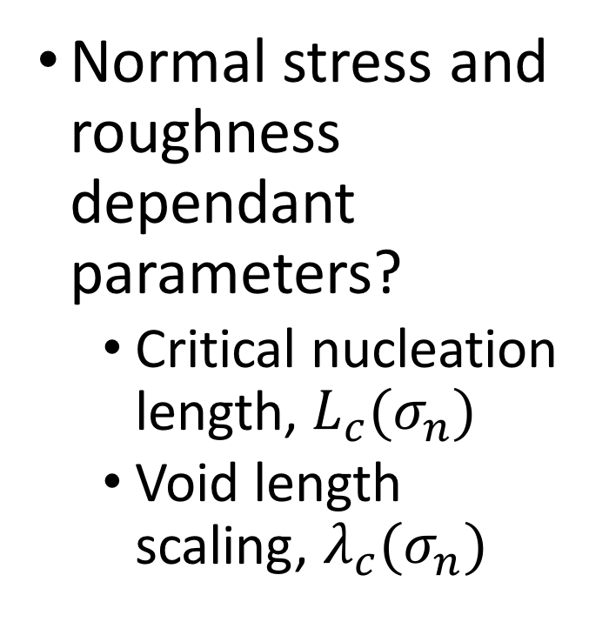
A departure from RSF?
Normal stress and roughness dependant parameters?
  Critical nucleation length, $L_{c}(σ_{n})$
  Void length scaling, $λ_{c}(σ_{n})$

Slide 20
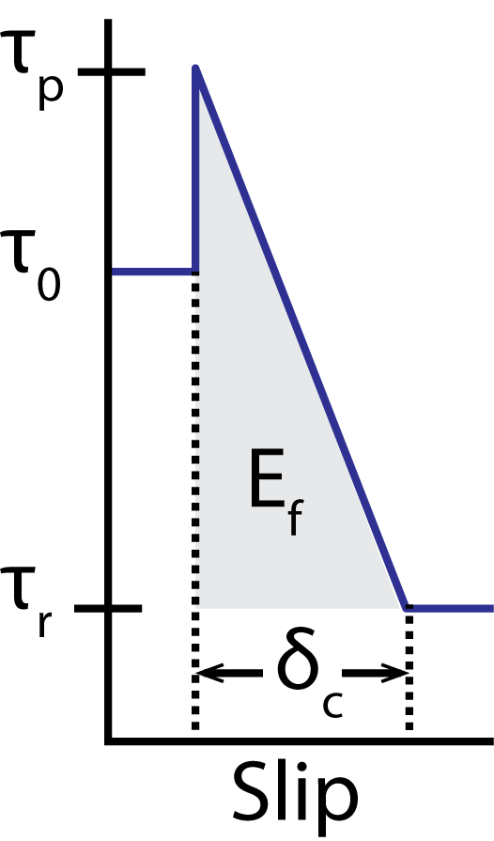
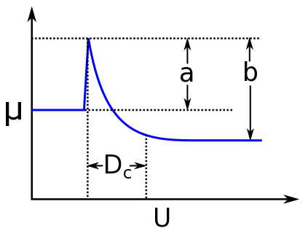


Nucleation length scaling
Rate and state formulation
Slip weakening formulation
H_{rr}*$=D_{c}\frac{μ^{′}}{σ\left(b−a\right)}$
Rice & Ruina, 1983
$L_{c}≈C^{′}F\frac{μ^{′}δ_{c}}{τ_{0}−τ_{r}}$
Andrews, 1976

Slide 21


Nucleation length scaling
Rate and state formulation
From RSF inversions, b-a=0.003, D_{c}=5$μm$
H_{rr}* = 1.03m at 100 MPa
Slip weakening formulation
Using $δ_{c}$=5$μm, Δτ=0.2$
L_{c} = 0.02m at 100 MPa

Slide 22
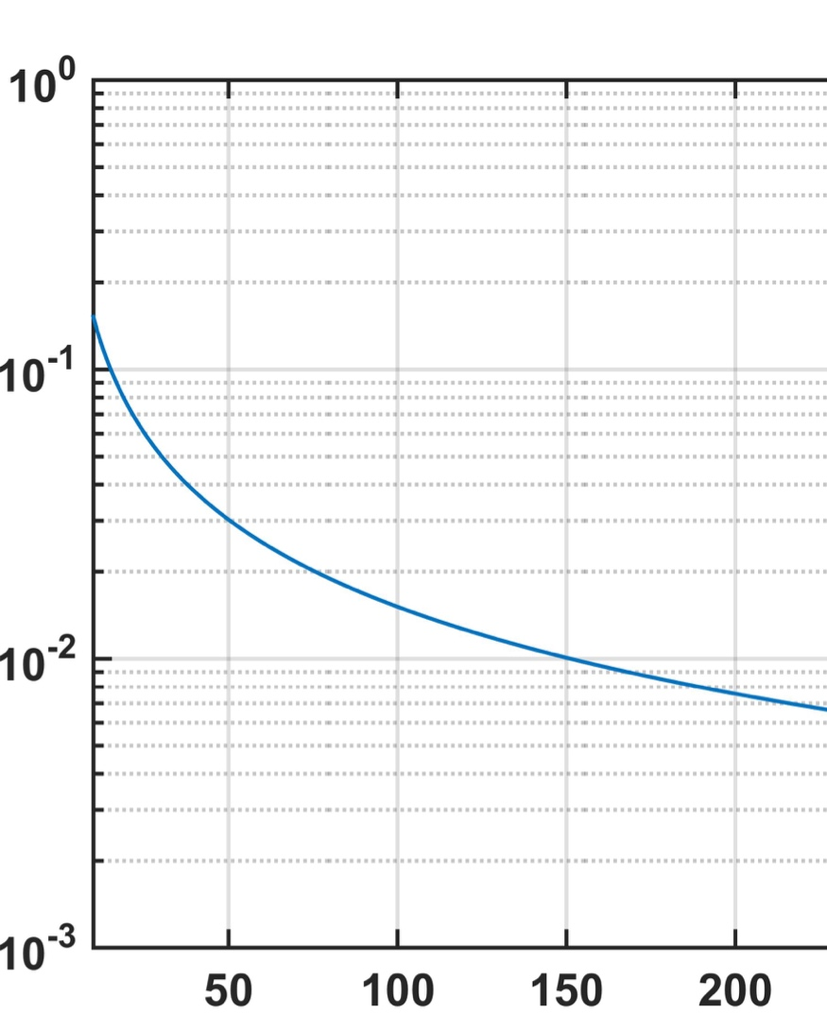

Nucleation length scaling
Slip weakening formulation
Onset of lab stick-slip
(Passelegue et al., 2013)
$L_{c}≈C^{′}Fδ_{c}\frac{μ^{′}}{τ_{0}−τ_{r}}$
Andrews, 1976
L_{c} [m]
Sample length
L_{c} ∝σ ⁻¹
Normal stress [MPa]

Slide 23
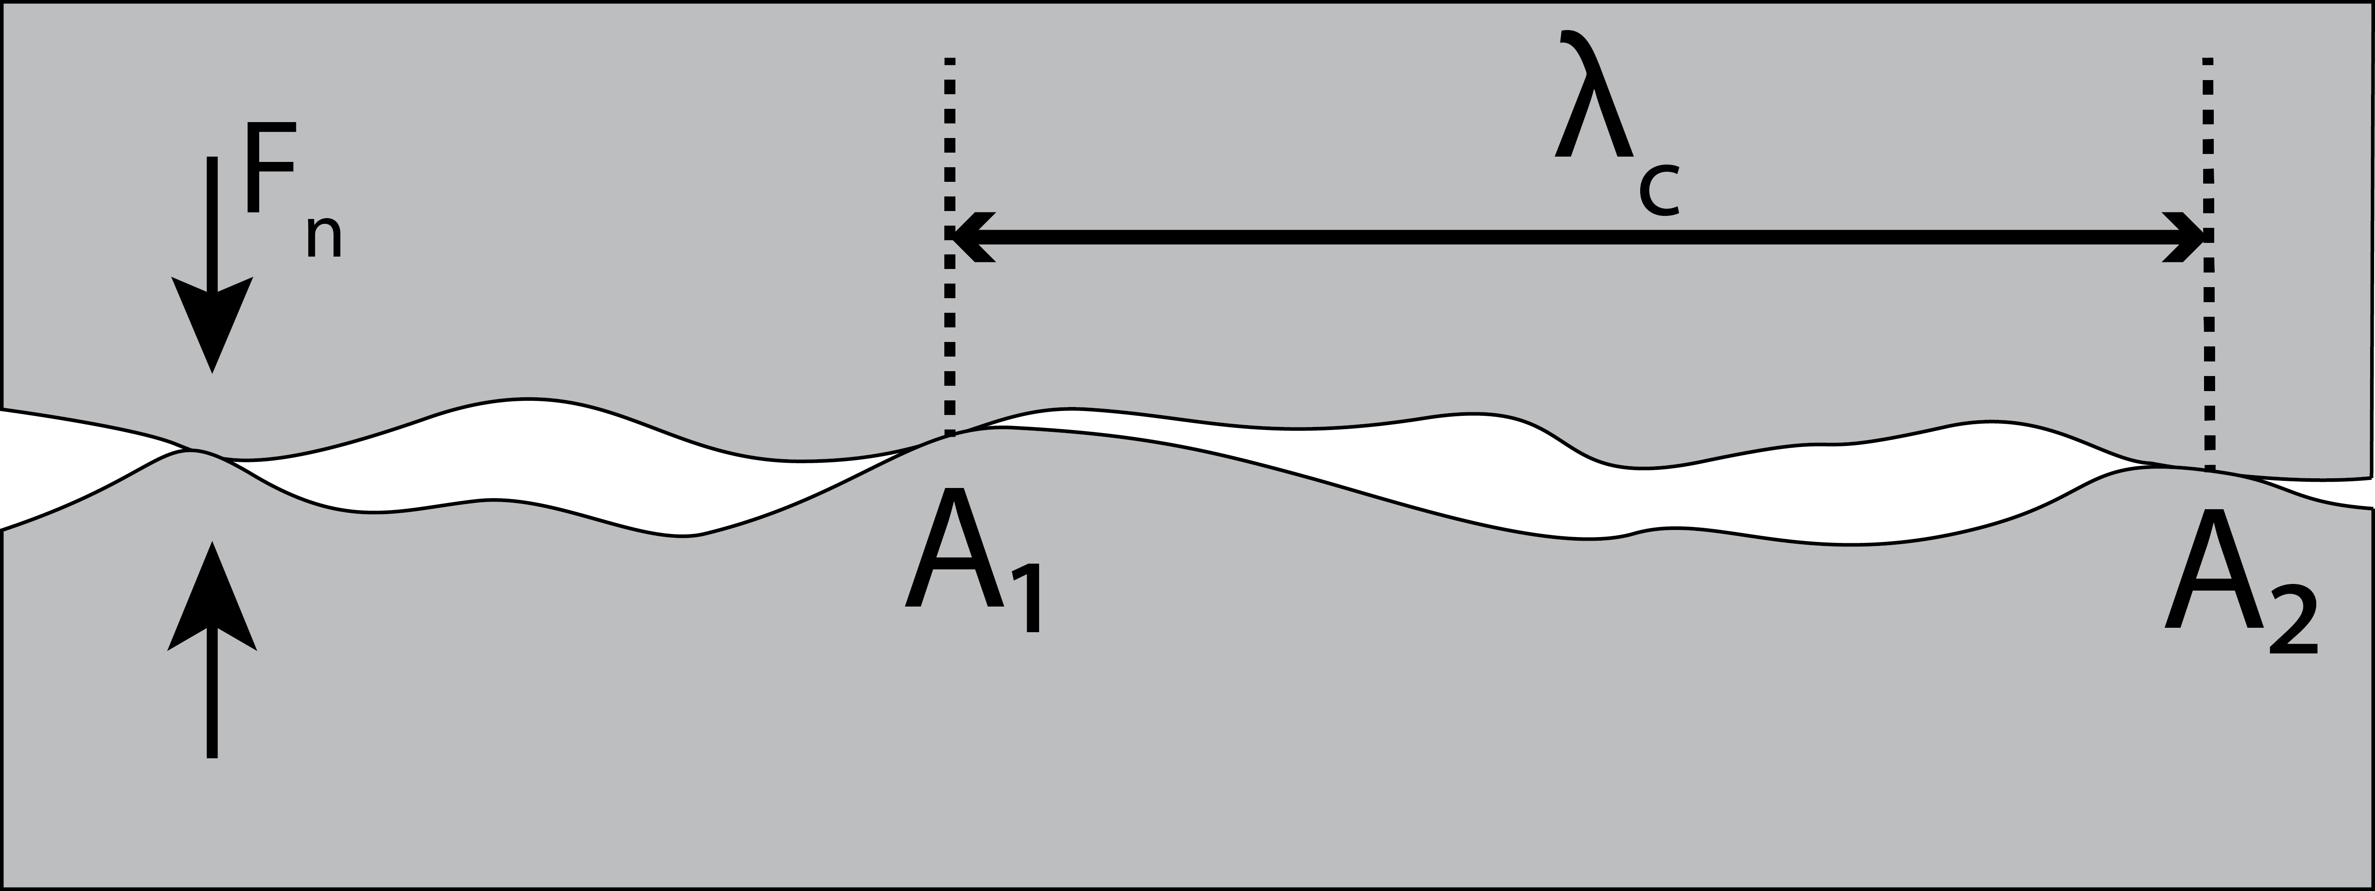
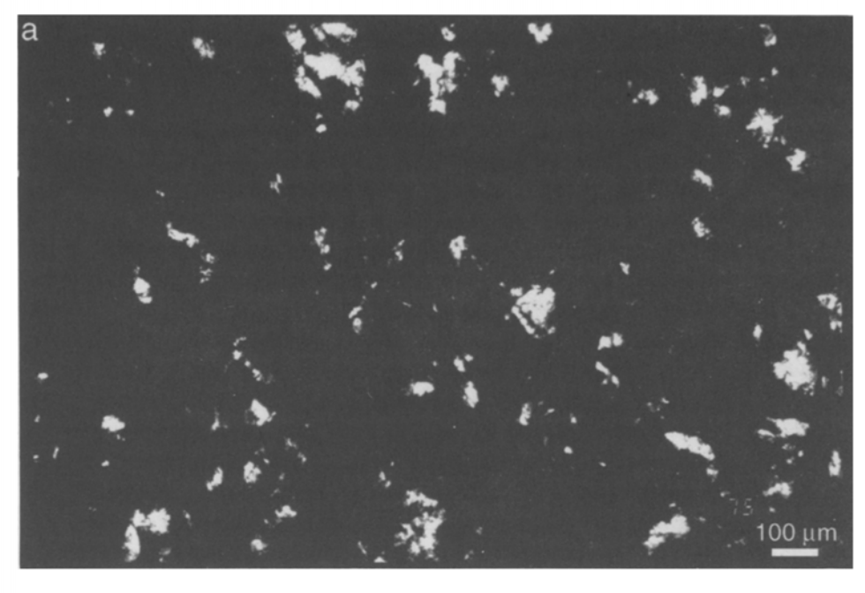
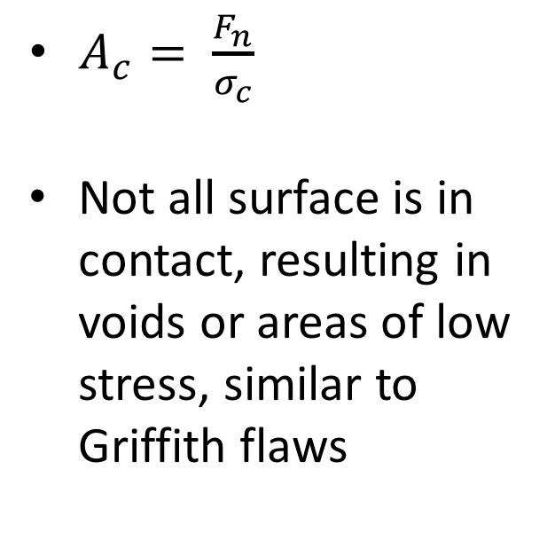
Void length scaling
$A_{c}= \frac{F_{n}}{σ_{c}}$
Not all surface is in contact, resulting in voids or areas of low stress, similar to Griffith flaws
Embedded
flaw
Image of contact in roughened Calcite (Dieterich & Kilgore 1994)

Slide 24
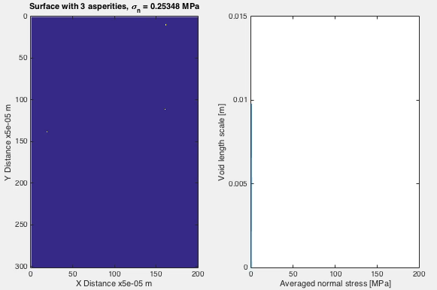
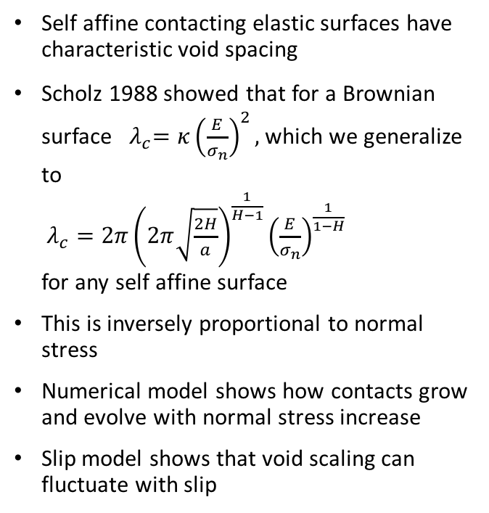
Elastic contact scaling- 2d elastic model
Self affine contacting elastic surfaces have characteristic void spacing
Scholz 1988 showed that for a Brownian surface ${ λ}_{c}=κ{\left(\frac{E}{σ_{n}}\right)}^{2},$which we generalize to $λ_{c}=2π{\left(2π\sqrt{\frac{2H}{a}}\right)}^{\frac{1}{H−1}}{\left(\frac{E}{σ_{n}}\right)}^{\frac{1}{1−H}}$ for any self affine surface
This is inversely proportional to normal stress
Numerical model shows how contacts grow and evolve with normal stress increase
Slip model shows that void scaling can fluctuate with slip
Notes:
Replace with new model of 2d stress

Slide 25
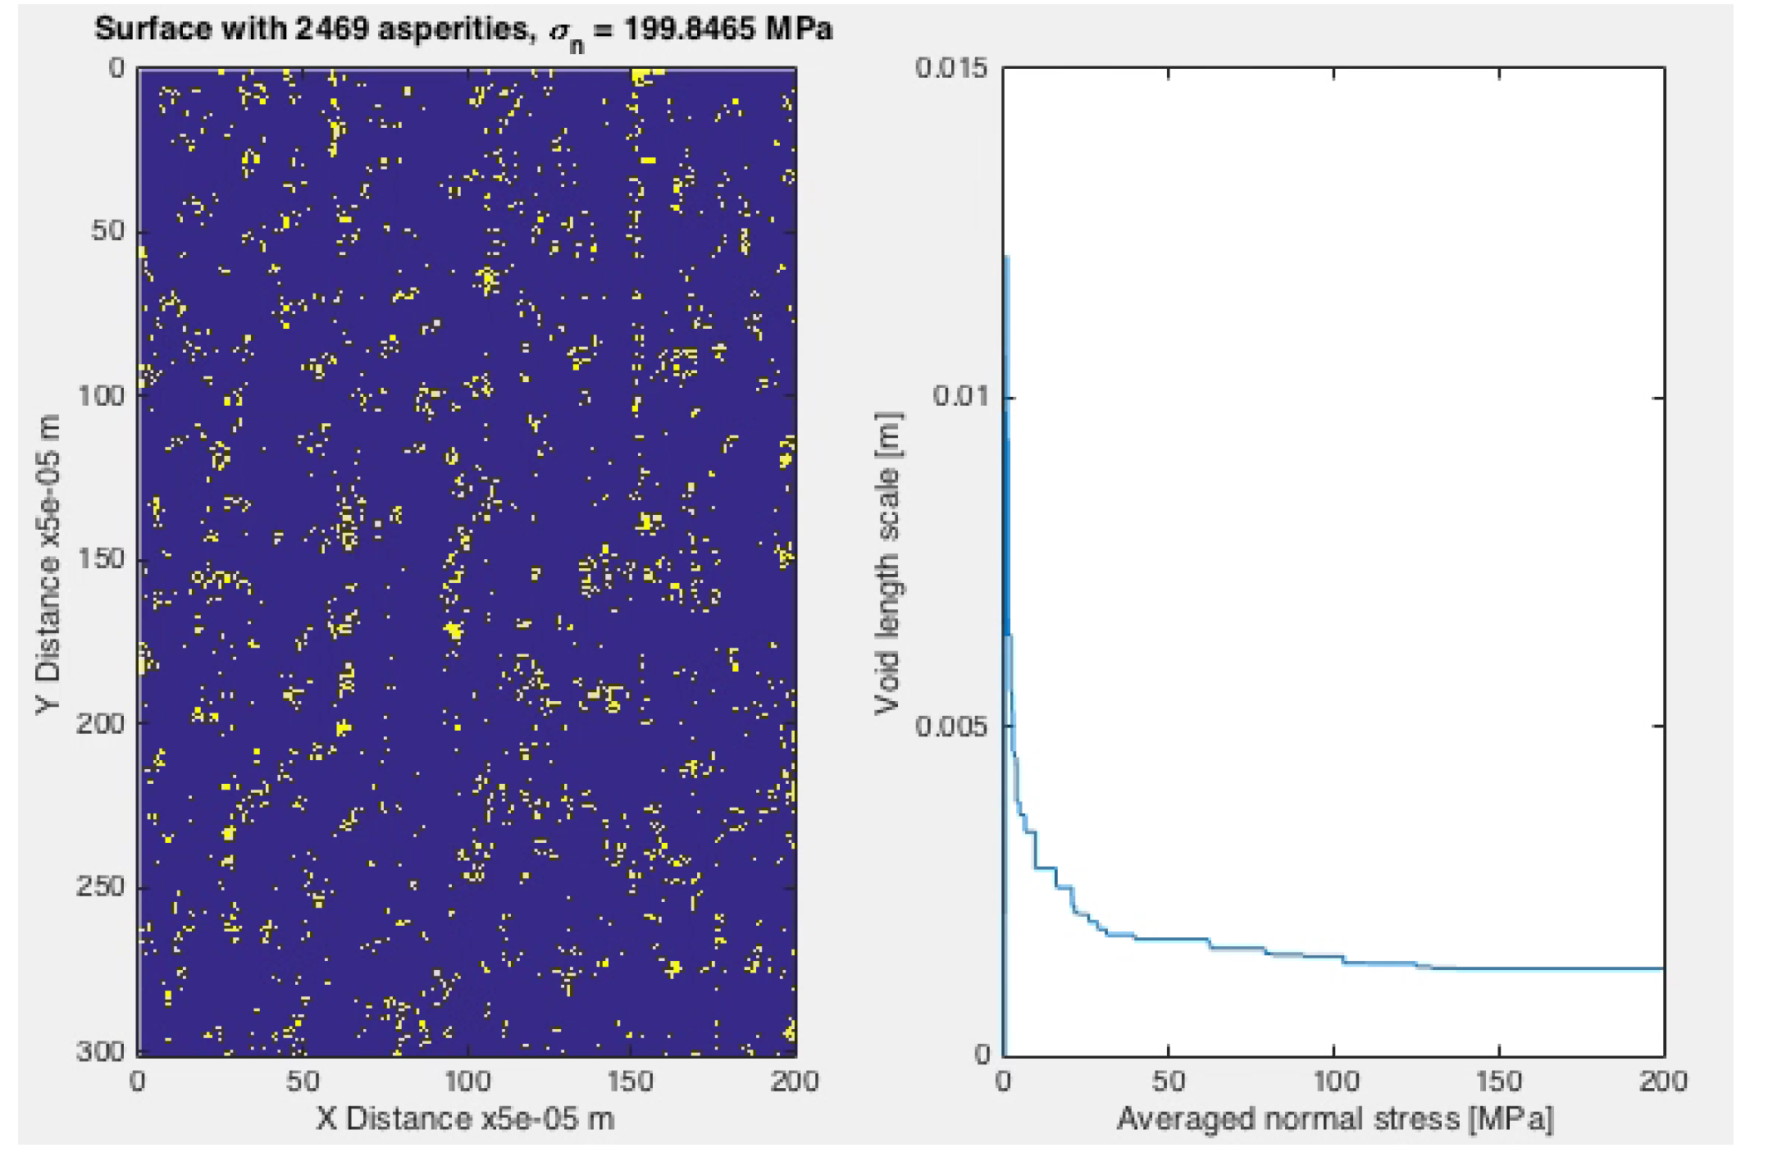
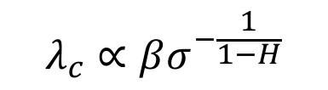
Elastic contact scaling- 2d elastic model
-5 to -2 for fault surfaces
$$λ_{c}∝βσ^{−\frac{1}{1−H}}$$
Self affine contacting elastic surfaces have characteristic void spacing
Scholz 1988 showed that for a Brownian surface ${ λ}_{c}=κ{\left(\frac{E}{σ_{n}}\right)}^{2},$which we generalize to $λ_{c}=2π{\left(2π\sqrt{\frac{2H}{a}}\right)}^{\frac{1}{H−1}}{\left(\frac{E}{σ_{n}}\right)}^{\frac{1}{1−H}}$ for any self affine surface
This is inversely proportional to normal stress
Numerical model shows how contacts grow and evolve with normal stress increase
Slip model shows that void scaling can fluctuate with slip
Notes:
Replace with new model of 2d stress

Slide 26
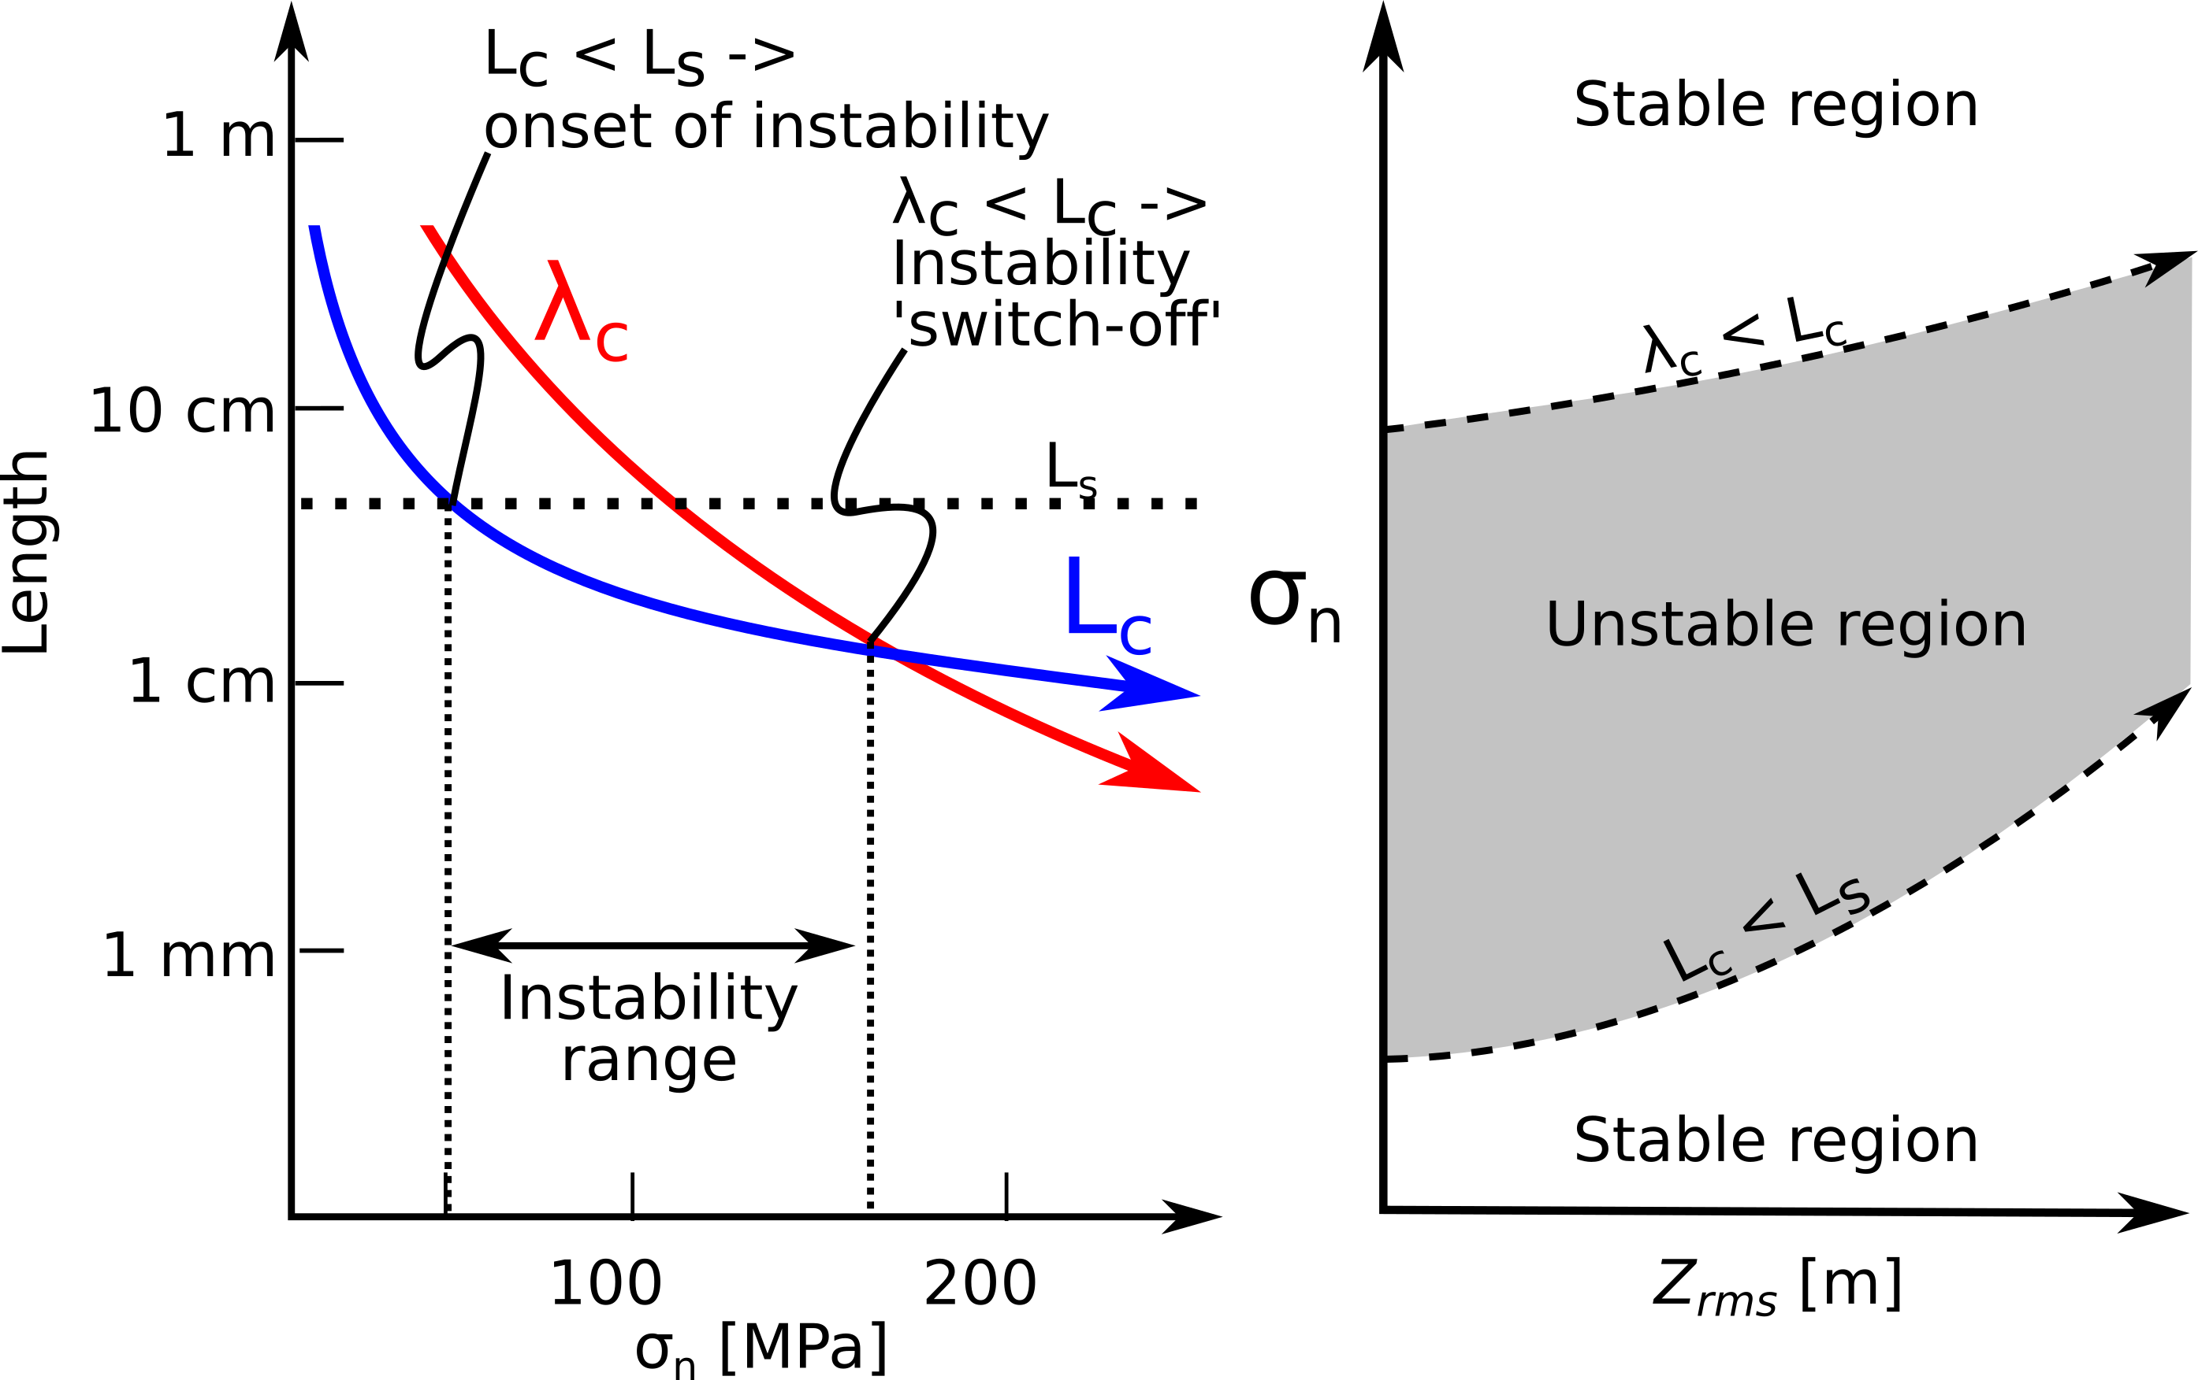
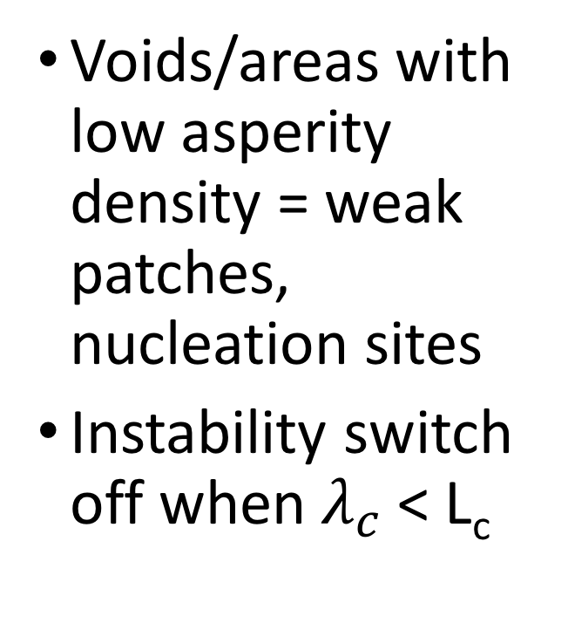
A new stability criterion?
Voids/areas with low asperity density = weak patches, nucleation sites
Instability switch off when $λ_{c}$ < L_{c}
Harbord et al. (In Press)

Slide 27
Harbord et al. (In Press)

Slide 28
Conclusion
Inhomogeneity on bare rough faults controls fault stability transitions
We propose it may be explained by a competition between the critical nucleation length, L_{c} and weak patch scaling, 𝜆_{c}
We may need to be more careful when inferring & modelling fault behaviours using rate- and state- parameters, inhomogeneity is important
Rate- and state- does not need replacing though!

Slide 29
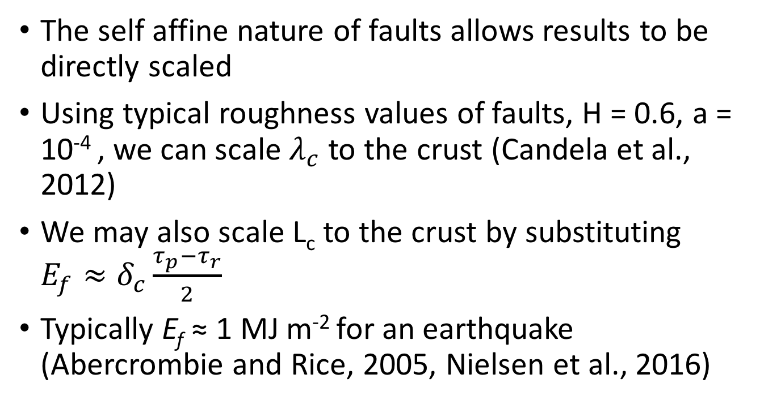
Speculation: Scaling lab results to real faults
The self affine nature of faults allows results to be directly scaled
Using typical roughness values of faults, H = 0.6, a = 10⁻⁴ , we can scale $λ_{c}$ to the crust (Candela et al., 2012)
We may also scale L_{c} to the crust by substituting ${E_{f}≈δ}_{c}\frac{τ_{p}−τ_{r}}{2}$
Typically E_{f} ≈ 1 MJ m⁻² for an earthquake (Abercrombie and Rice, 2005, Nielsen et al., 2016)

Slide 30
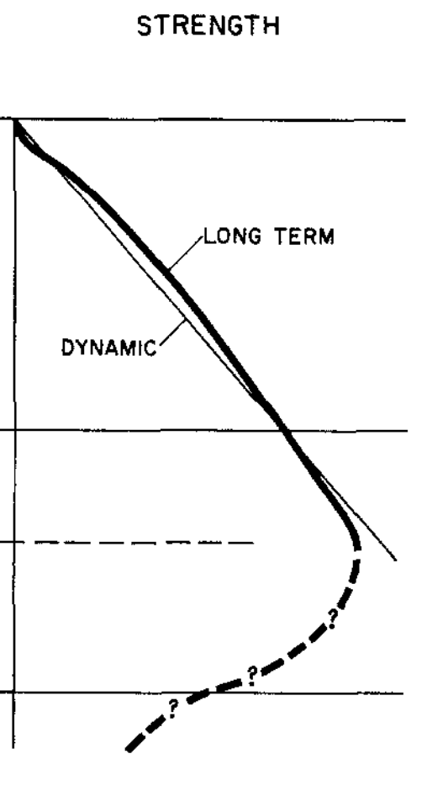
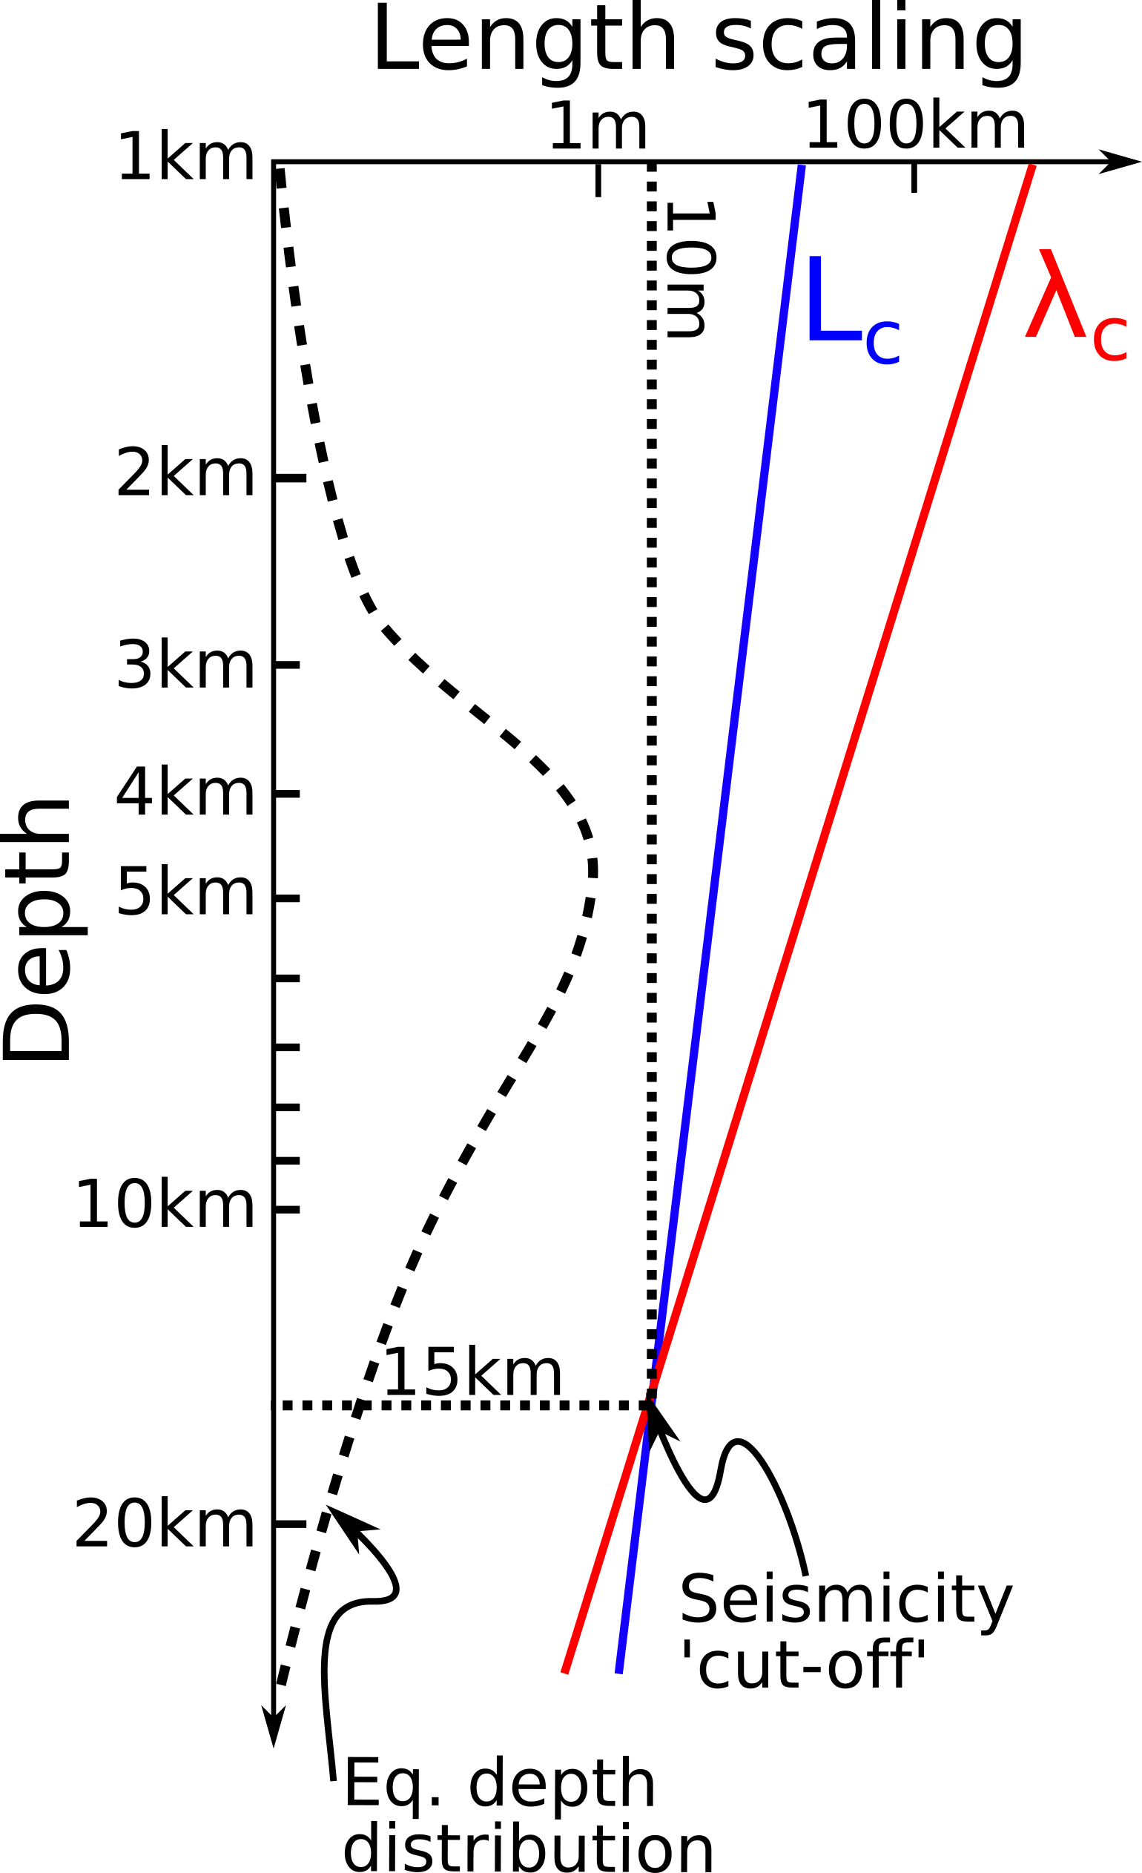
Speculation: Scaling lab results to real faults
An additional mechanism to rheological Sibson-Scholz models of seismicity depth distribution?

Slide 31
Questions
Thank you for listening!
Email: c.w.a.harbord@durham.ac.uk
Twitter: @rockonCH
Citations:
Abercrombie & Rice, 2005, GJI
Candela et al. 2012, JGR Solid Earth
Marone 1998, Annu. Rev. Earth Planet. Sci.
Nielsen et al. 2016, GRL
Passelegue et al. 2013, Science
Rice & Ruina 1983, JGR
Scholz 1988, Nature
Scholz 1998, Nature

Slide 32
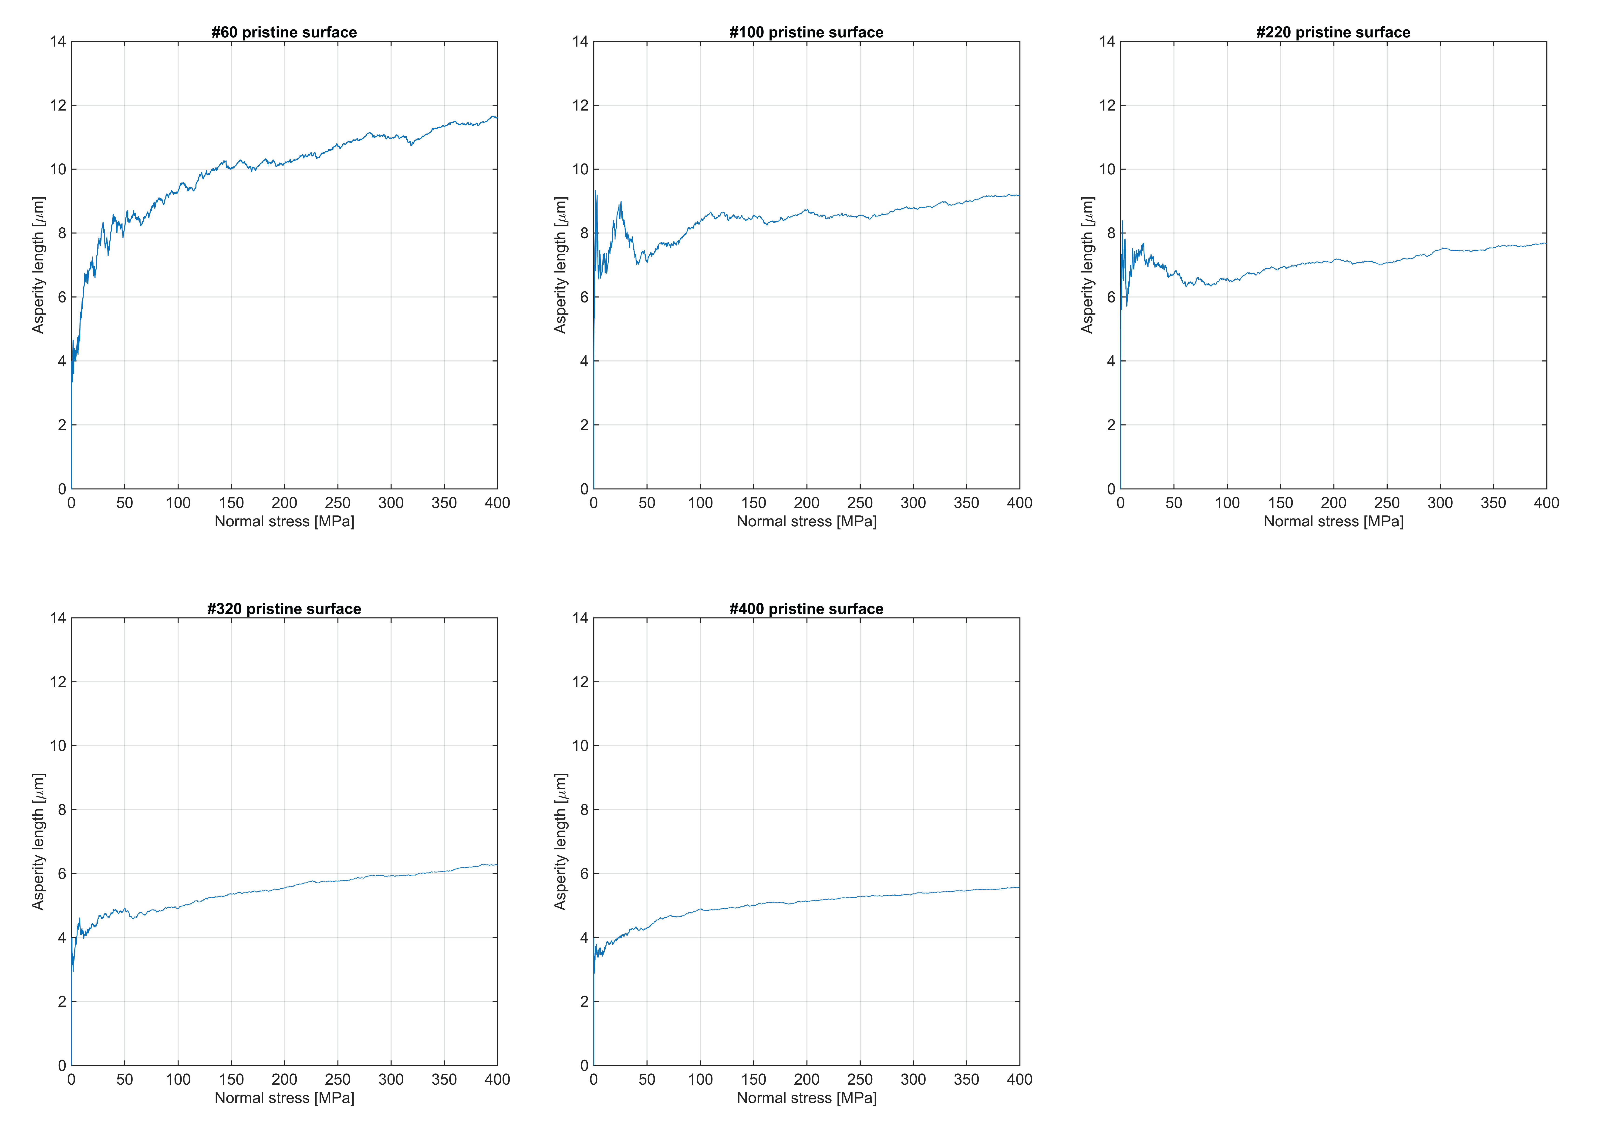
Asperity length modelling

Slide 33
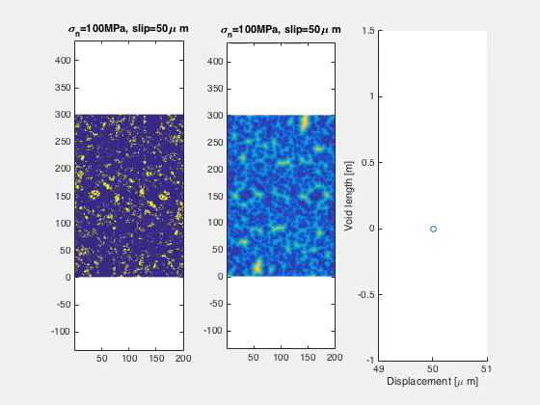
Effects of slip on asperity distributions

Slide 34

Generalisation of 𝜆_{c}
$λ_{c}=2π{\left(2π\sqrt{\frac{2H}{a}}\right)}^{\frac{1}{H−1}}{\left(\frac{E}{σ_{n}}\right)}^{\frac{1}{1−H}}$

