Slide 1
Coda Wave Interferometry (CWI) for Time-Lapse Monitoring
Jonathan Singh (jonathan.singh@ed.ac.uk)
A Curtis, I Main, A Cartwright-Taylor, I B Butler, M Chapman, F Fusseis
Notes:
1

Slide 2
Outline
What is the Velocity?
CWI for Monitoring Velocity Change
Experimental Rock Physics Applications

Slide 3
Velocities in Complex Media
High X ray density
760 μm
Low X ray density
Berea Sandstone from Madonna et al 2013

Slide 4
Digital Rock Physics
Density & Velocity of Water
Density & Velocity of Quartz
760 μm
4
4

Slide 5
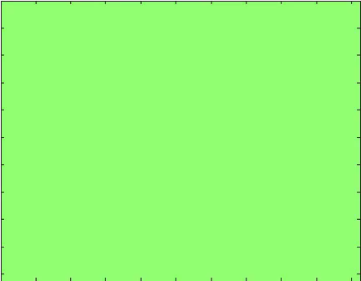
Digital Rock Physics
Simulated Wavefield
Source Wavelet: 35 MHz
760 μm
5

Slide 6
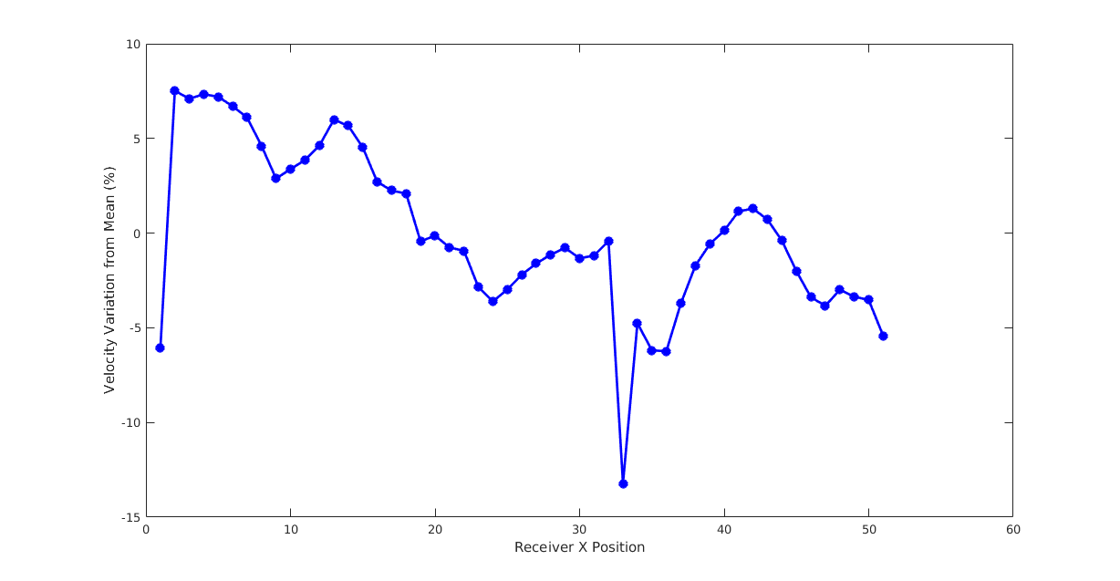
Variations in apparent velocity
Velocity calculated from the standard method is strongly dependent on the positions of the sources and receiver.
10
Calculated from first break arrival
0
cv
Velocity Variation from Mean (%)
cv
-15
Receiver X Position
6

Slide 7
Variations in apparent velocity
Velocity calculated from the standard method is strongly dependent on the positions of the sources and receiver.
10
Calculated from first break arrival
0
cv
Velocity Variation from Mean (%)
20%
cv
-15
Receiver X Position
7

Slide 8
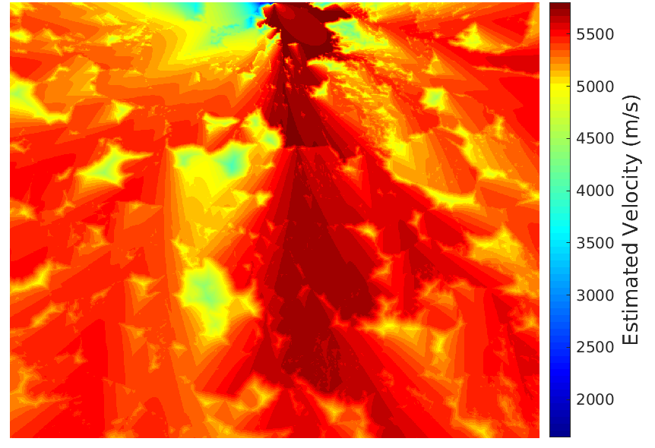
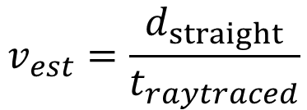
What’s the velocity?
Fast Marching Eikonal Solver (CREWES toolbox)
$$v_{est}=\frac{d_{straight}}{t_{raytraced}}$$
760 μm
8

Slide 9
What’s the velocity?
Fast Marching Eikonal Solver (CREWES toolbox)
$$v_{est}=\frac{d_{straight}}{t_{raytraced}}$$
760 μm
9

Slide 10
What’s the velocity?
Fast Marching Eikonal Solver (CREWES toolbox)
$$v_{est}=\frac{d_{straight}}{t_{raytraced}}$$
760 μm
10

Slide 11
What’s the velocity?
Fast Marching Eikonal Solver (CREWES toolbox)
$$v_{est}=\frac{d_{straight}}{t_{raytraced}}$$
760 μm
11

Slide 12
What’s the velocity?
Fast Marching Eikonal Solver (CREWES toolbox)
$$v_{est}=\frac{d_{straight}}{t_{raytraced}}$$
760 μm
What’s the sample velocity?
Velocity estimate is very different depending on where you measure
12

Slide 13
Coda Wave Interferometry

Slide 14
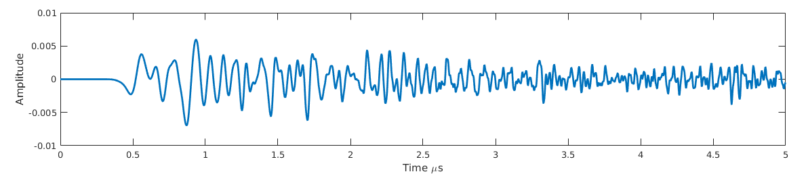
Coda Wave Interferometry

Slide 15
Coda Wave Interferometry
Primary and secondary

Slide 16
Coda Wave Interferometry
Coda

Slide 17
Coda Wave Interferometry

Slide 18
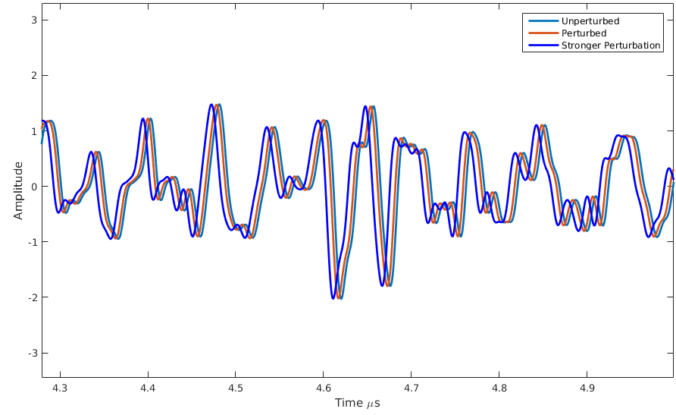
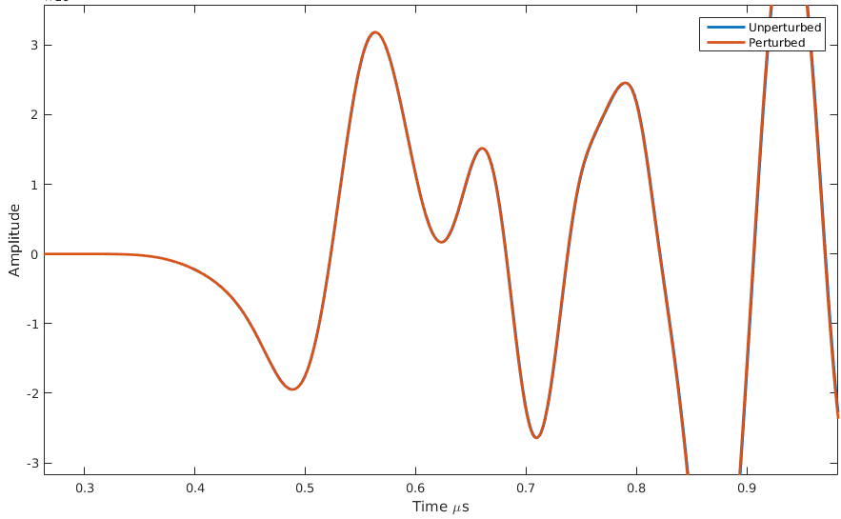
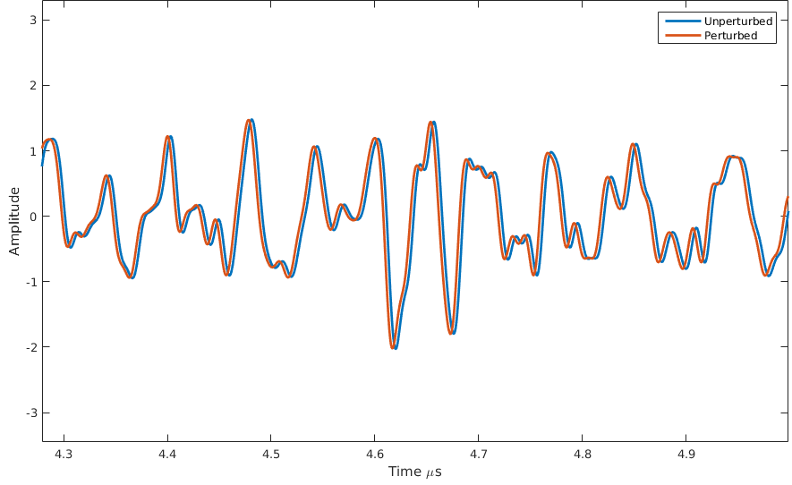
Coda Wave Interferometry

Slide 19
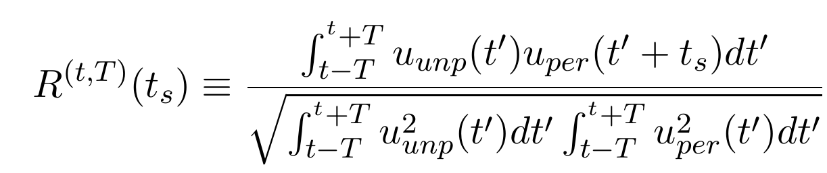
Coda Wave Interferometry
Use time shift (t_{s}) from cross correlation:
Theory derived in Sneider 2006

Slide 20
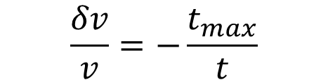
Coda Wave Interferometry
$$\frac{δv}{v}=−\frac{t_{max}}{t}$$
Theory derived in Sneider 2006

Slide 21
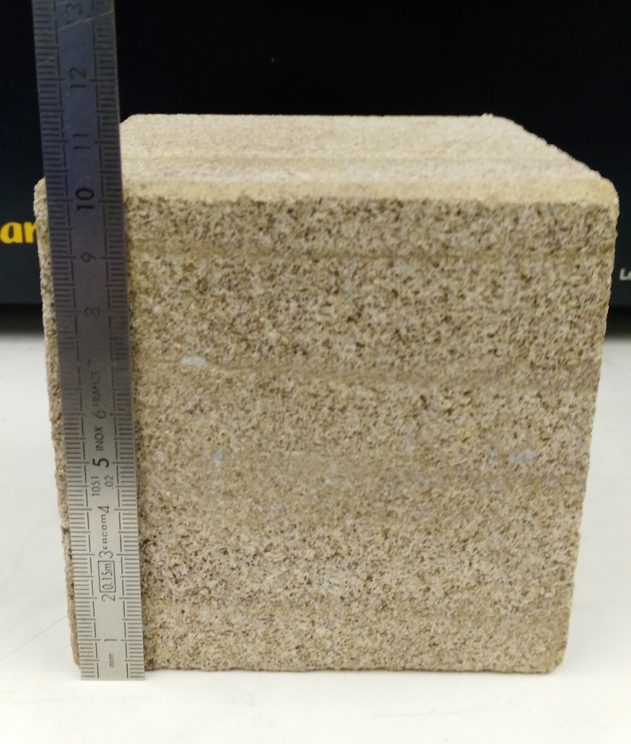
Velocity vs Temperature
Temperature measured from external thermocouple
Velocity survey every minute
10cm
Halldale Sandstone

Slide 22
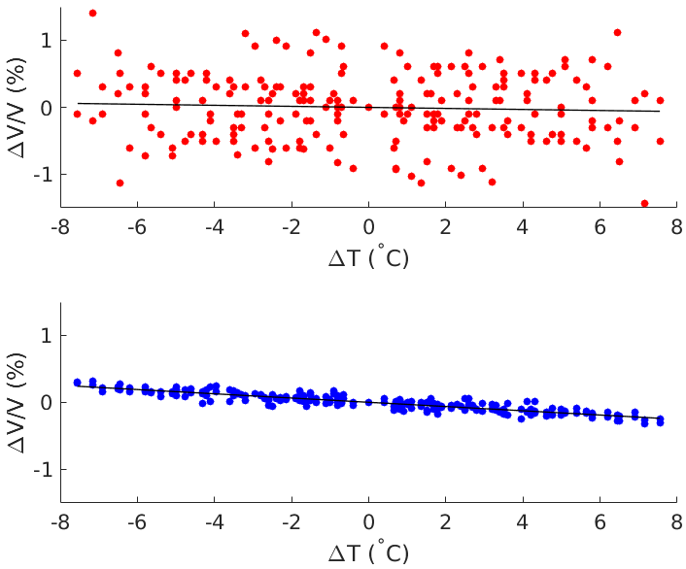
Velocity vs Temperature
Using First Arrivals
Variation in velocity not resolved above noise
Using CWI
Clear and coherent velocity response

Slide 23
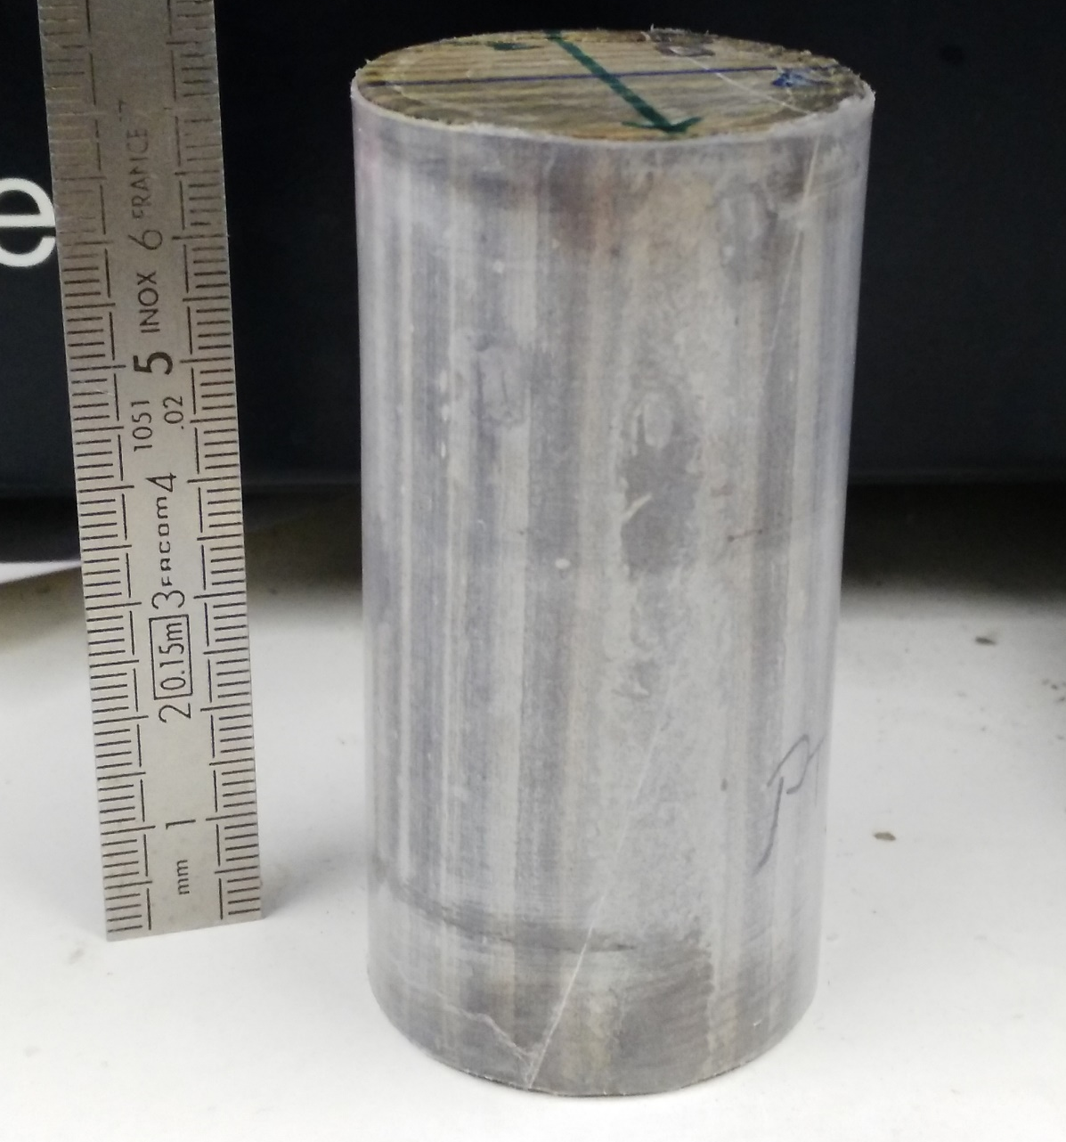
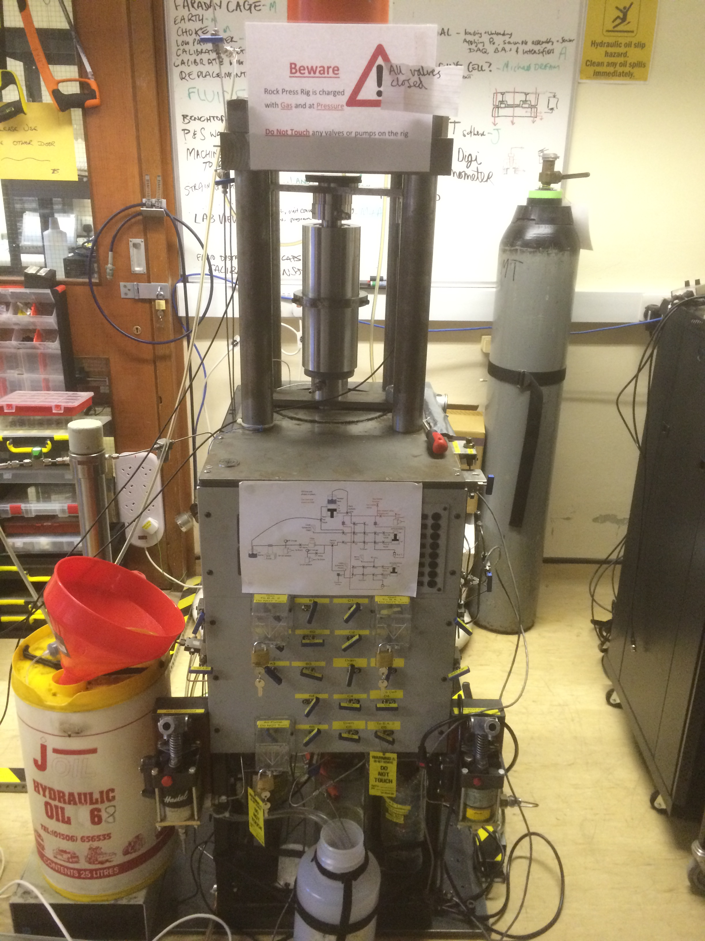
Rock Deformation
Fine grained laminated carbonate
Effective Pressure : 45 MPa
Differential Stress: < 250 MPa

Slide 24
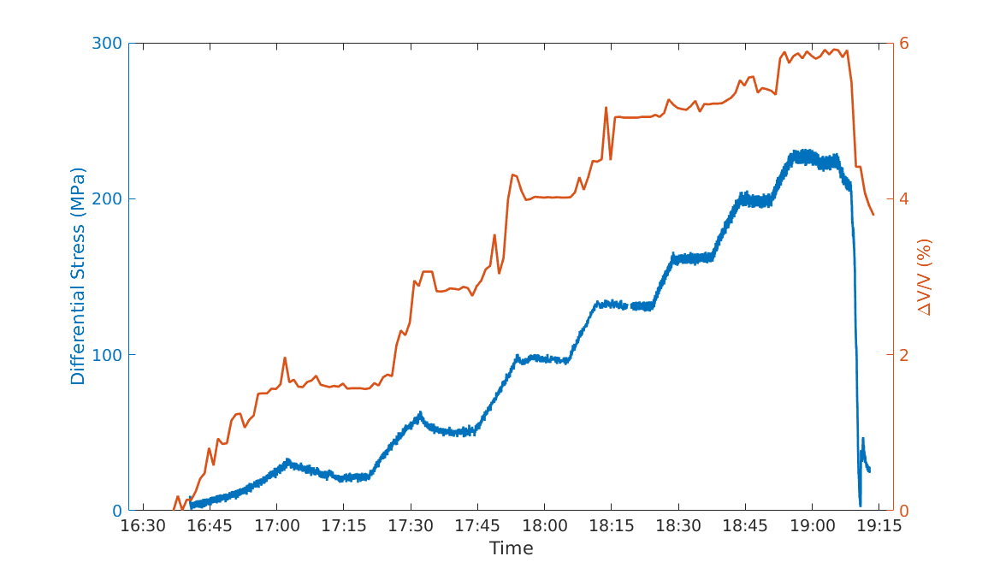
Rock Deformation
Strain rate = 10⁻⁵ s⁻¹
Stepped Velocity Response
Stepped Stress Program
for permeability measurements

Slide 25
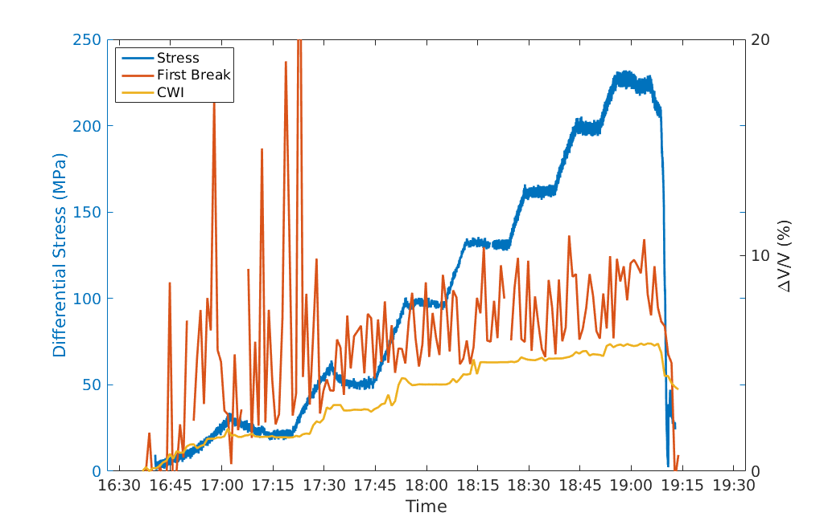
Rock Deformation
First breaks fail to show stepped response

Slide 26
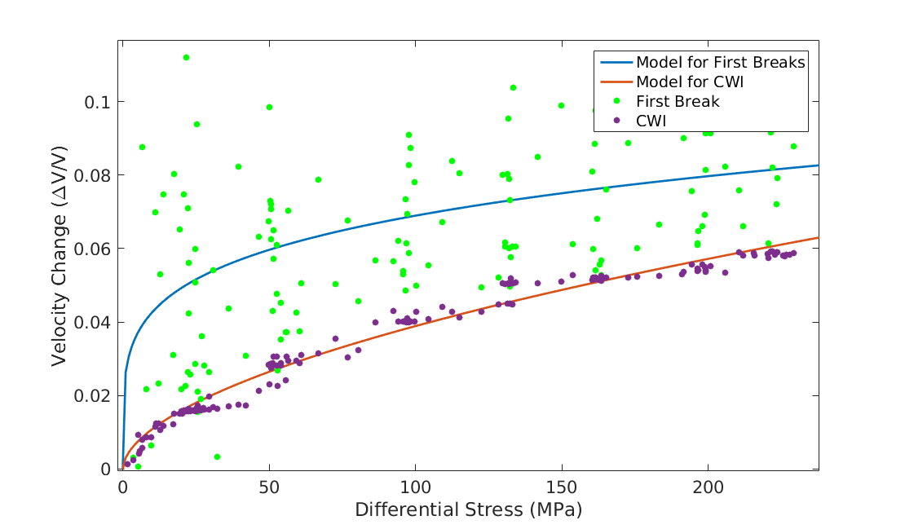

Rock Deformation
Hertz-Mindilin Model
$$V=kP^{h}$$

Slide 27
Summary
Velocity is not representative for a medium
CWI sensitively samples the bulk properties
Clear response to temperature and effective stress
Code to be made available and Paper to be submitted

