Slide 1
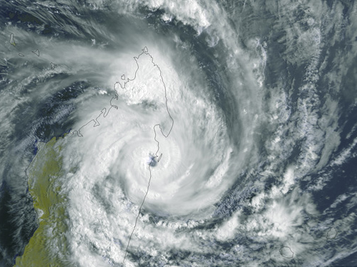
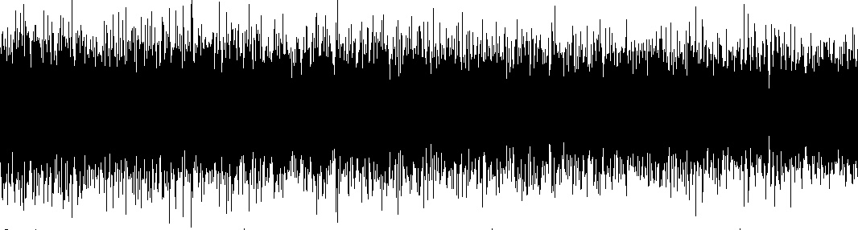







Frequency dependent microseismic sources
E. Stutzmann¹
M. Meschede¹, V. Farra¹, M. Schimmel²,
F. Ardhuin³, L. Gualtieri⁴, A. Mangeney¹
Institut de Physique du Globe de Paris, France
CSIC-ICJTA, Barcelona, Spain
IFREMER, Brest, France
Lamont-Doherty Earth Observatory, Columbia University, USA

Slide 2
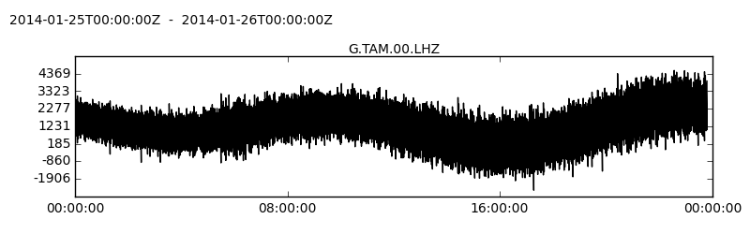
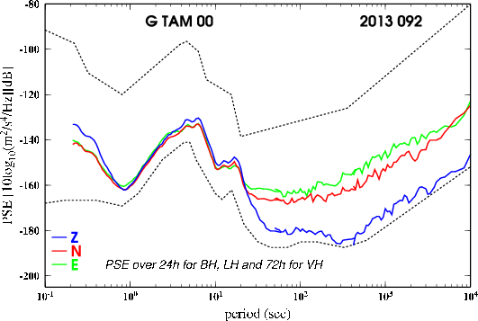
Seismic noise
Strongest signal
= Rayleigh waves
Spectrum over one day
-80
-100
-120
-140
-160
-180
-200
Primary
microseisms
Secondary
microseisms
Acceleration PSD (Log( m².s³))
Hum
0.1 1 10 100 1000 10000
Period (s)
Noise with periods between 1 and 500 sec are generated by oceans waves

Slide 3
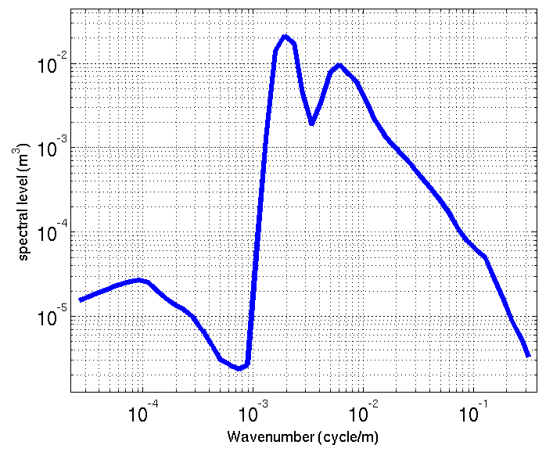
Ocean wave spectrum
ocean wave spectrum
swell
10⁻²
10⁻³
10⁻⁴
10⁻⁵
wind-sea
Spectral level (m³)
Infragravity
waves
10m 100m 1km 10km wavelength
Wind sea and swell→ primary and secondary microseisms
Infragravity waves → hum
Longuet-Higgins, 1950
Hasselmann, 1963

Slide 4
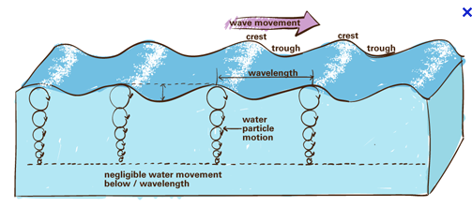
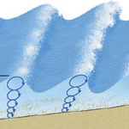
Motion in a compressible ocean
x
Gravity
waves dominate
h
P₁ source
P₂ source
Ocean
Compression waves
(long wavelength) dominate
Ocean bottom
Crust
z
2 mechanisms generate seismic sources:
- primary mechanism (P1): wave-sea floor interaction at the coast
- secondary mechanism (P2): wave-wave interaction
Longuet-Higgins, 1950
Hasselmann, 1963
Notes:
Gravity waves similar to surface waves in incompressible fluid. They decreases rapidly with depth
Compression waves of large wvelength controlled by the compressibility of the medium. Not attenuated with depth

Slide 5
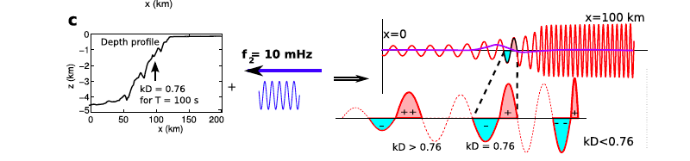
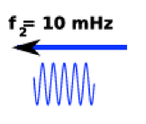
Ocean waves (period 10-20 sec) along sea floor close to the coast → Primary microseism
Ocean infragravity waves (period 30-300 sec) along the continental shelf → Hum
Primary mechanism: interaction wave-coast
frequency = 10mHz
Ardhuin, Gualtieri, Stutzmann, 2015

Slide 6
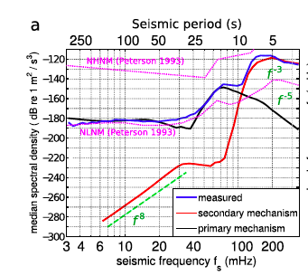
Primary mechanism: interaction wave-coast
Ocean waves computed with Code WAVEWATCH III
→ primary mechanism pressure source
Station SSB in France (GEOSCOPE)
-120
-140
-160
-180
-200
-220
-240
-260
-280
-300
Primary
microseisms
Hum
Data
Secondary microseism
Primary mechanism
5 10 25 50 100 250
period (sec)
Correct amplitude for the primary microseisms and the hum
Ardhuin, Gualtieri, Stutzmann, 2015

Slide 7
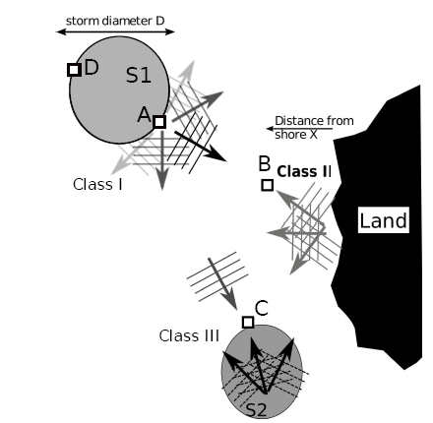
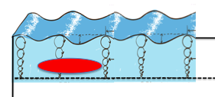
Secondary microseism sources (period 1-10 s)
Ocean waves: wind sea and swell
computed with Code WAVEWATCH III
Interaction of waves with similar frequency f and opposite directions
Pressure source of frequency 2f
close to the ocean surface
Ocean bottom
Ardhuin, Stutzmann et al., 2011

Slide 8

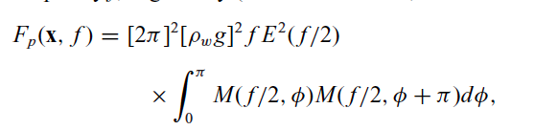
Secondary microseism sources (period 1-10 s)
Sources: - Random pressure field close to the the ocean surface
- Pressure at 2 different locations are independent.
PSD of the random pressure field F_{p} (Pa² m² s):
sea surface elevation PSD (m² s)
non-dimensional
ocean gravity wave term
azimuth
Hasselmann, 1963, Ardhuin et al. , 1911, Farra et al. , 2016

Slide 9
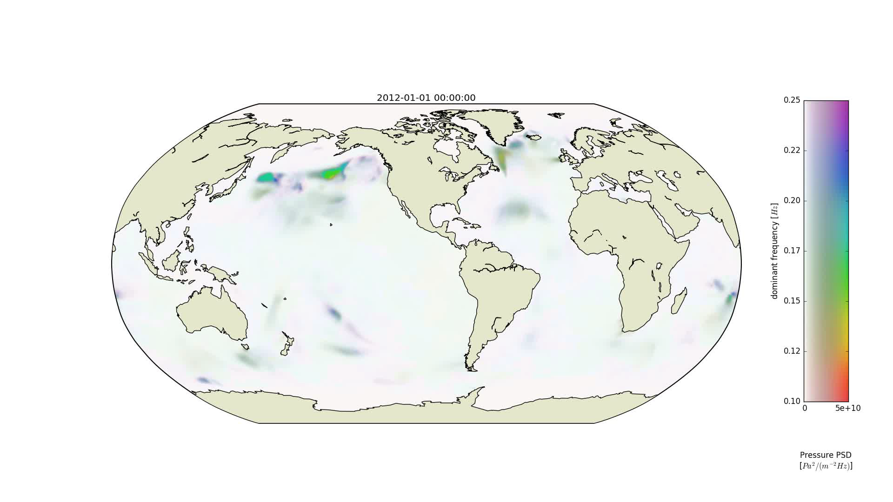
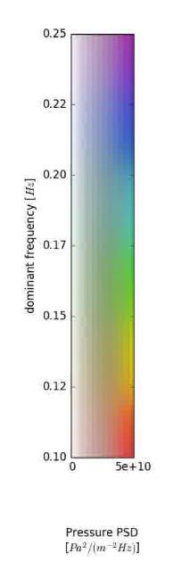
Secondary microseism sources (period 1-10 s)
Meschede, Stutzmann, Ardhuin, 2017

Slide 10
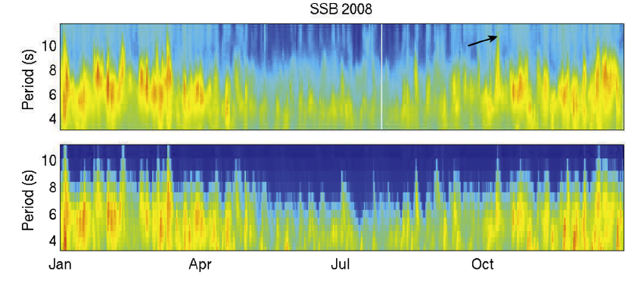
Mostly Rayleigh waves:
Secondary microseism modeling (period 1-10 s)
Data
Synthetic
Good agreement that can still be improved:
- Wave model coastal reflection not well known
Seismic attenuation no well known for periods 3-10 s
Source site effect do not includes sediments
Stutzmann at al. 2012

Slide 11
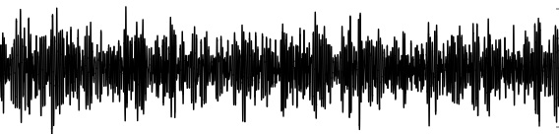
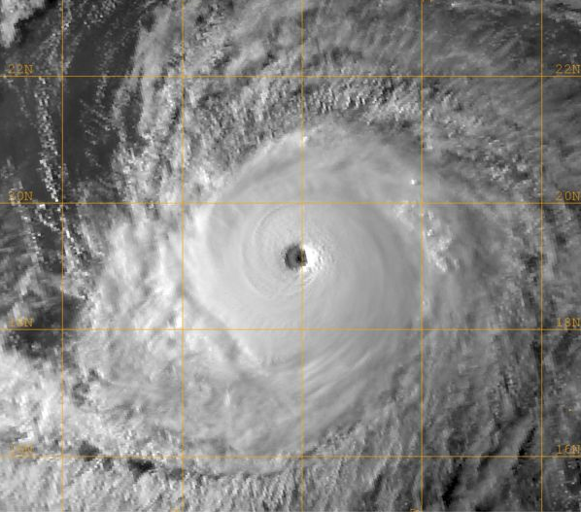
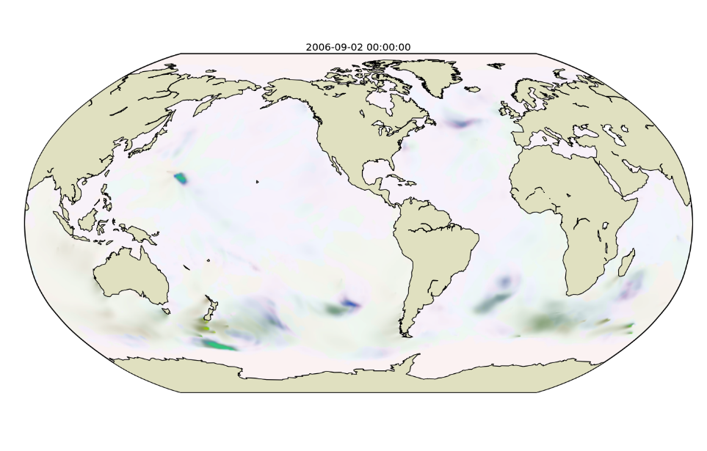
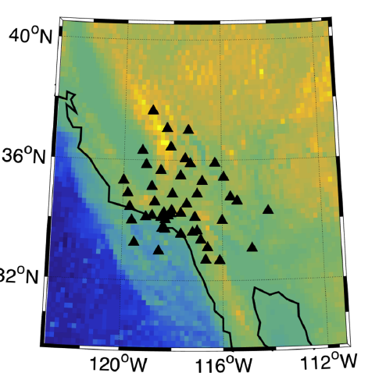
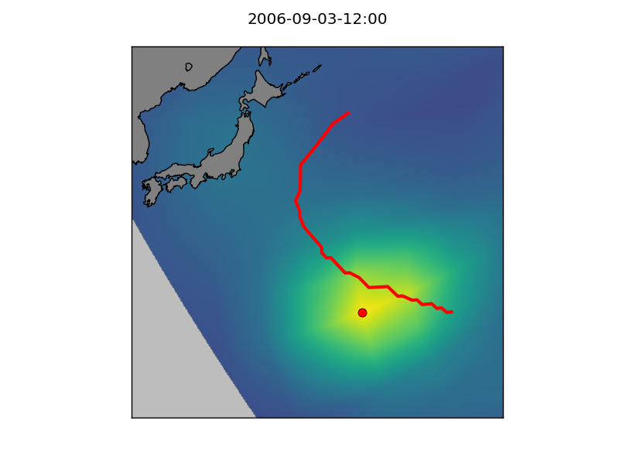
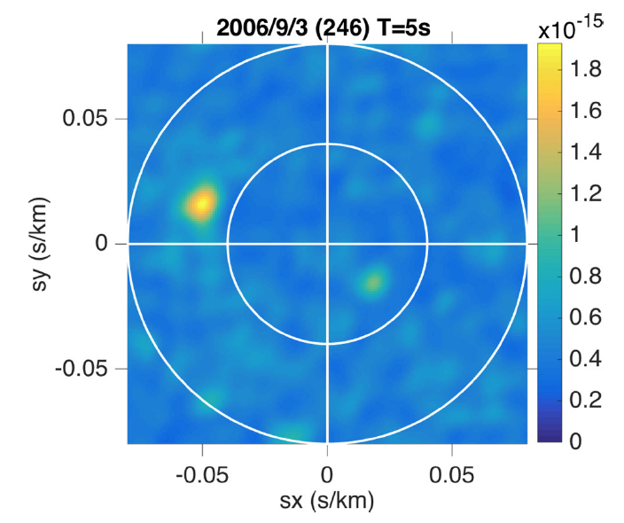
Secondary microseisms body waves
Typhon Ioke
California
Beamforming
Back projection
Typhon
track
e. g. Zhang et al. 2010, Gualtieri et al. 2014

Slide 12

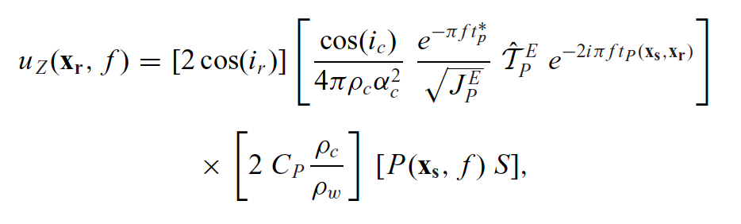
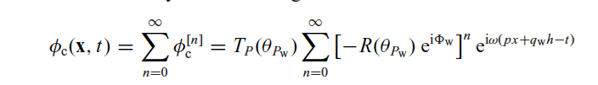

Modelling secondary microseism P-waves
Source:
In the far field:
Vertical force at the top of
the crust without ocean
Source site effect:
(Gualtieri et al., 2014)
P
…
⬄
ocean
S
P
P
P
crust
P
S
P-wave potential:
= source site effect: Cp
Gualtieri et al., 2014

Slide 13
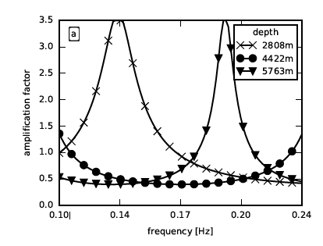
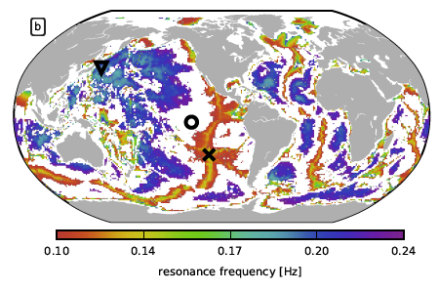
Source site effect
Meschede et al., submitted

Slide 14
P-wave vertical displacement
Displacement due
to a vertical force
Phase term with
P-wave travel time t_{p}
Receiver site effect
.
Equivalent to vertical force at top of the
crust and no ocean
Farra et al., 2016

Slide 15
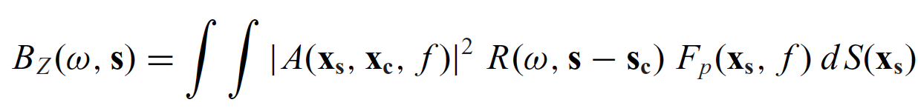
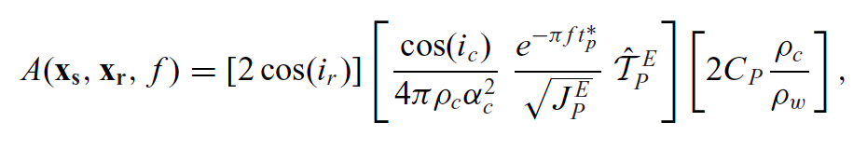
Synthetic beam:
Array response
Pressure PSD over
Surface dS
Farra et al., 2016

Slide 16
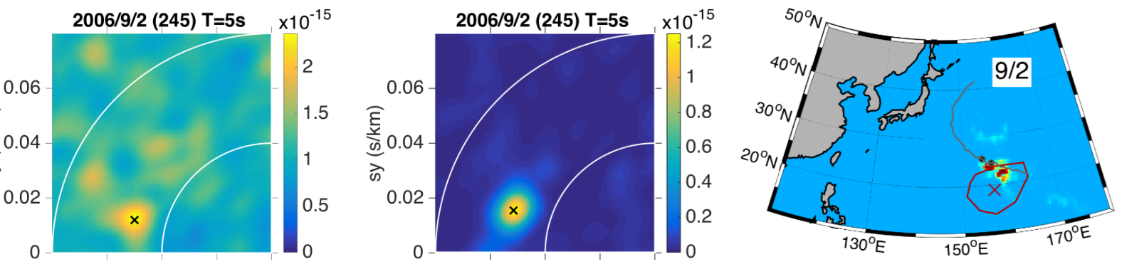
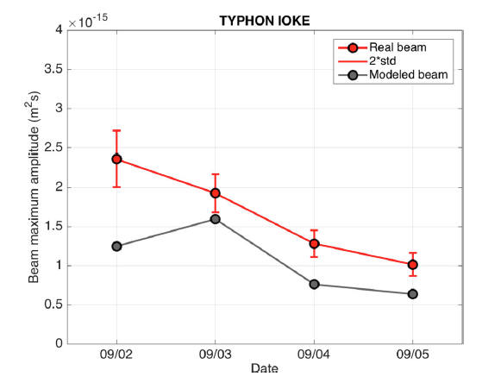
Observed beam Synthetic beam Back projection
Beam for a period of 5 s
Farra et al., 2016

Slide 17
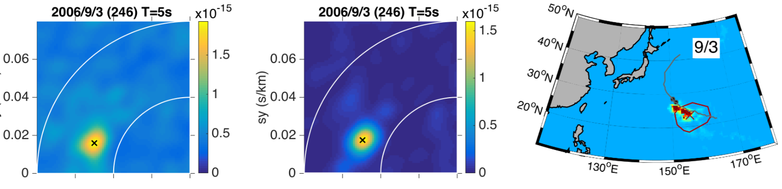
Observed beam Synthetic beam Back projection
Beam for a period of 5 s
Farra et al., 2016

Slide 18
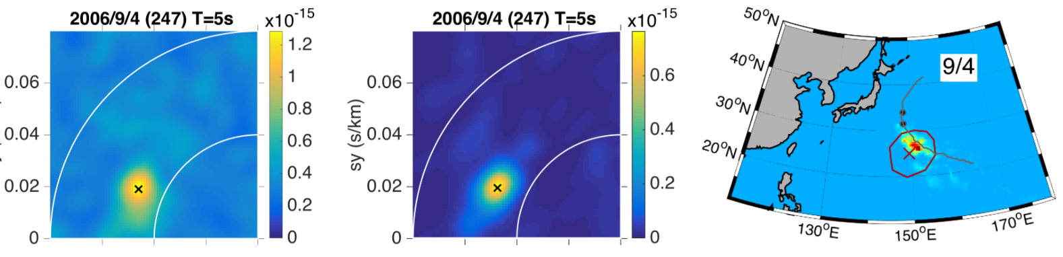
Observed beam Synthetic beam Back projection
Beam for a period of 5 s
Farra et al., 2016

Slide 19
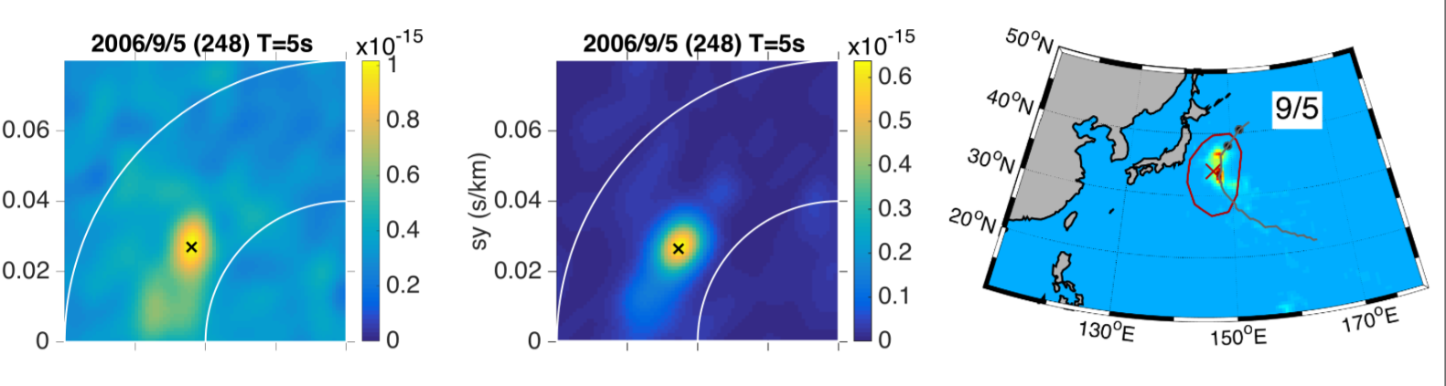
Beam for a period of 5 s
Observed beam Synthetic beam Back projection
Farra et al., 2016

Slide 20
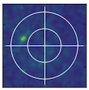
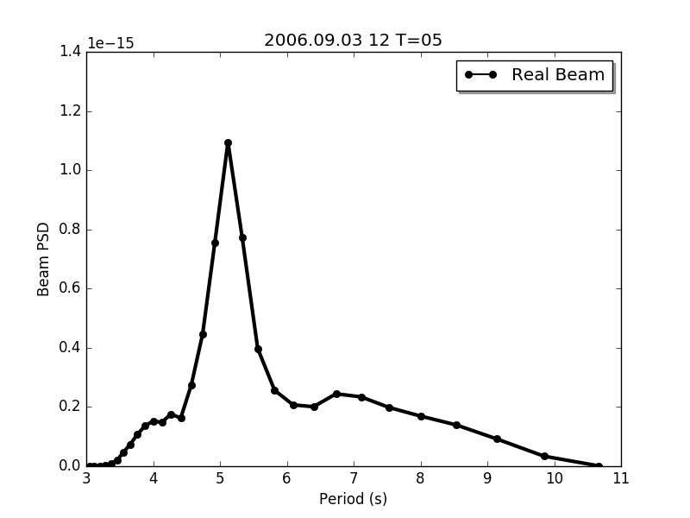
Beam spectrum

Slide 21
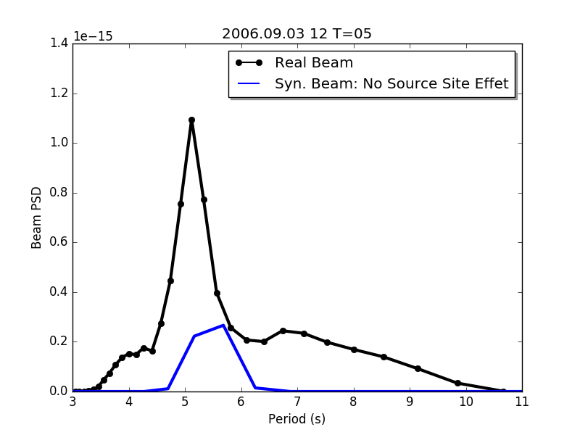
Beam spectrum

Slide 22
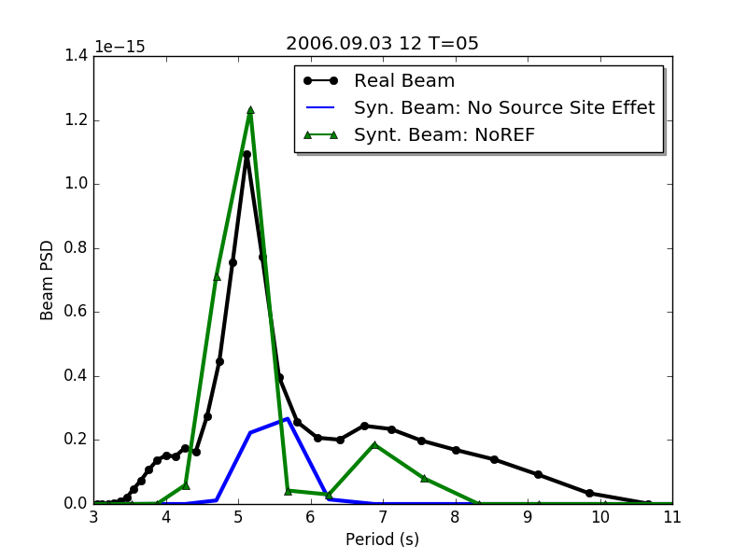
Beam spectrum

Slide 23
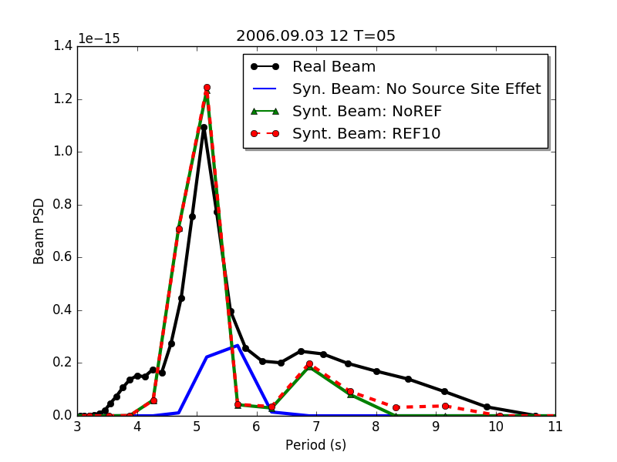
Beam spectrum

Slide 24
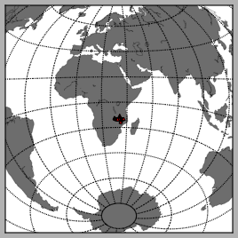
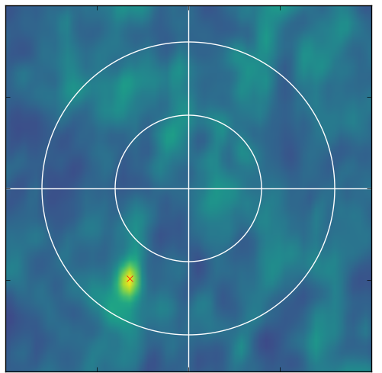
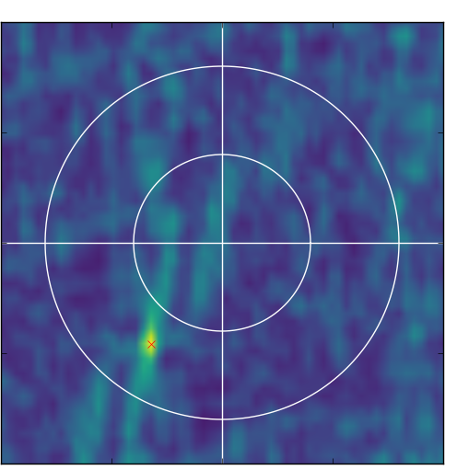
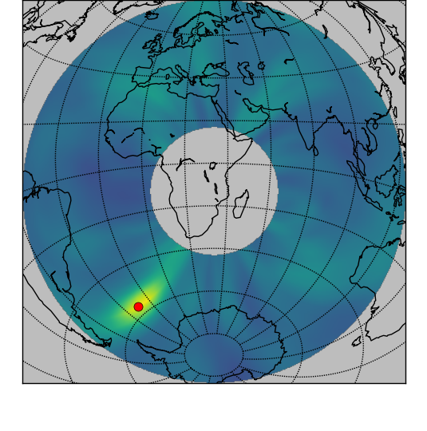
Source in the southern hemisphere
African rift netwrok (XK)
Real beam (7.5s)
Synthetic beam
Back
Projection
(AK network)
Notes:
python plot_beam_spectrum.py data/XK_AFRICAN_RIFT_2013/2013.176.00.00.beam.npz --period 7
(26/6)

Slide 25
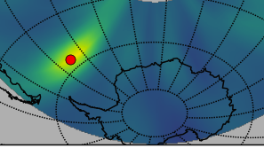
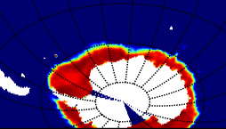
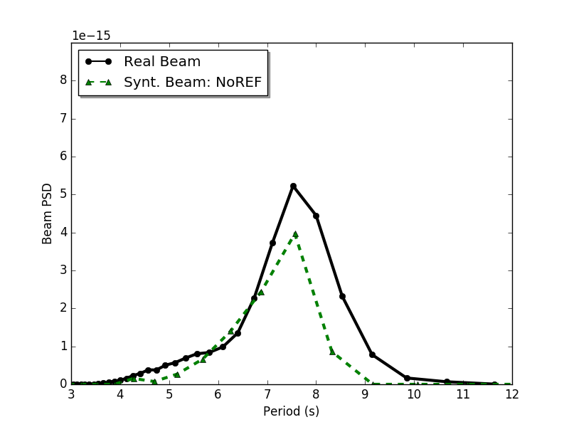
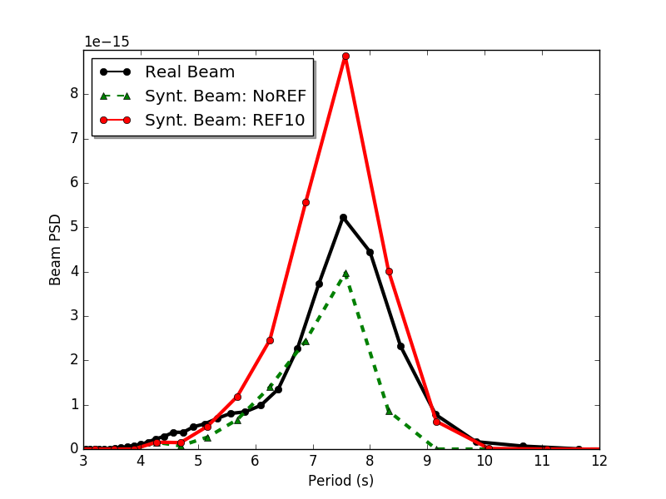
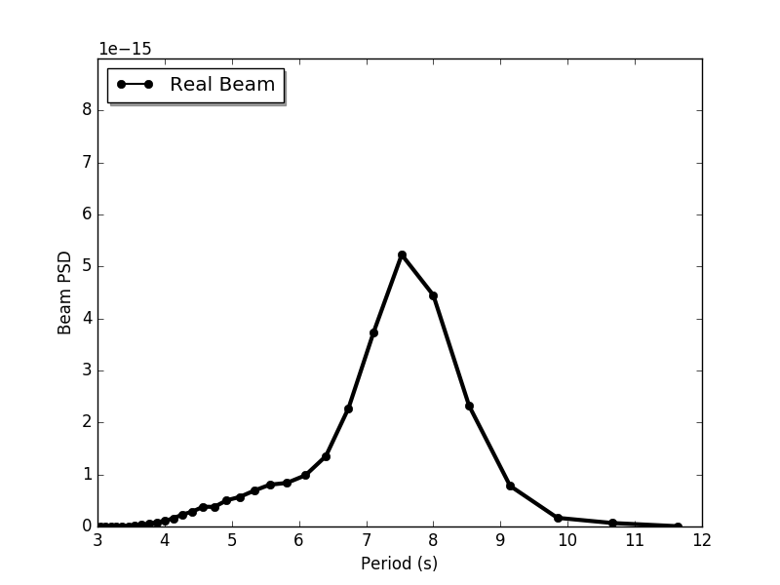
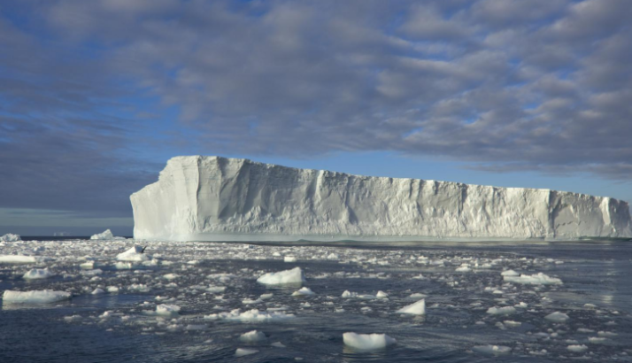
Source close to icebergs and sea ice
Zoom
Sea ice and icebergs (June)
Notes:
python plot_beam_spectrum.py data/XK_AFRICAN_RIFT_2013/2013.176.00.00.beam.npz --period 7
(26/6)

Slide 26
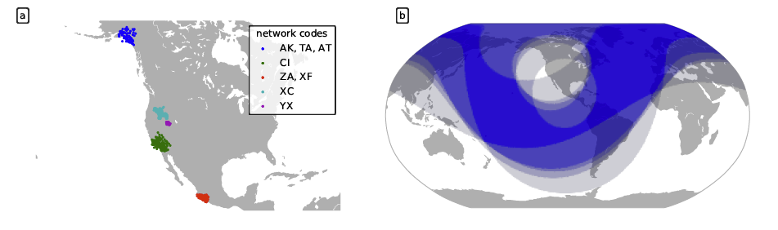
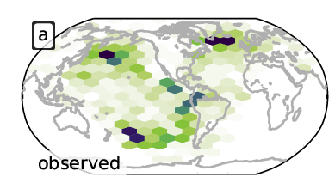

Secondary microseism sources at global scale
Sources:
Back projection of
the daily beams maximum
Meschede, Stutzmann, Farra, Schimmel, Ardhuin submitted

Slide 27



Comparison between observations and models
No coastal Reflection
With coastal Reflection
No source site effect
Meschede et al. submitted

Slide 28






Matching sources
Energy
Modeled maximum
Beam PSD (m²/Hz)
Frequency
Modeled frequency
Meschede et al. submitted

Slide 29


2 peaks
Average beam spectra
Source site effect:
Meschede et al. submitted

Slide 30

All sources
Meschede et al. submitted

Slide 31

Conclusion
Seismic signal source between 3-300s can be explained by 2 mechanisms:
- wave-wave interactions
- (infra-) wave interactions with the coast
Sources and source site effect are both frequency
dependent: some sources are amplified and others are
extinguished
Microseismic surface waves and body waves can be accurately modelled
Microseismic body waves:
- Beam spectra are modulated by the source site effect. The ocean bathymetry
distribution emphasizes sources at 5s and 7s periods.
- Sources detected in 3 regions (Greenland, North Western Pacific and South
Pacific) are accurately modeled.
- Source along the South American coast are observed but not accurately modeled.
- Sources related to ocean wave reflected on icebergs are detected
Frequency dependent reflection coefficient is needed to model them accurately.

Slide 32


Slide 33


